Slide 1







Connaught Public School
Connaught Be More Healthy School Produce Market
and Breakfast Program

Slide 2


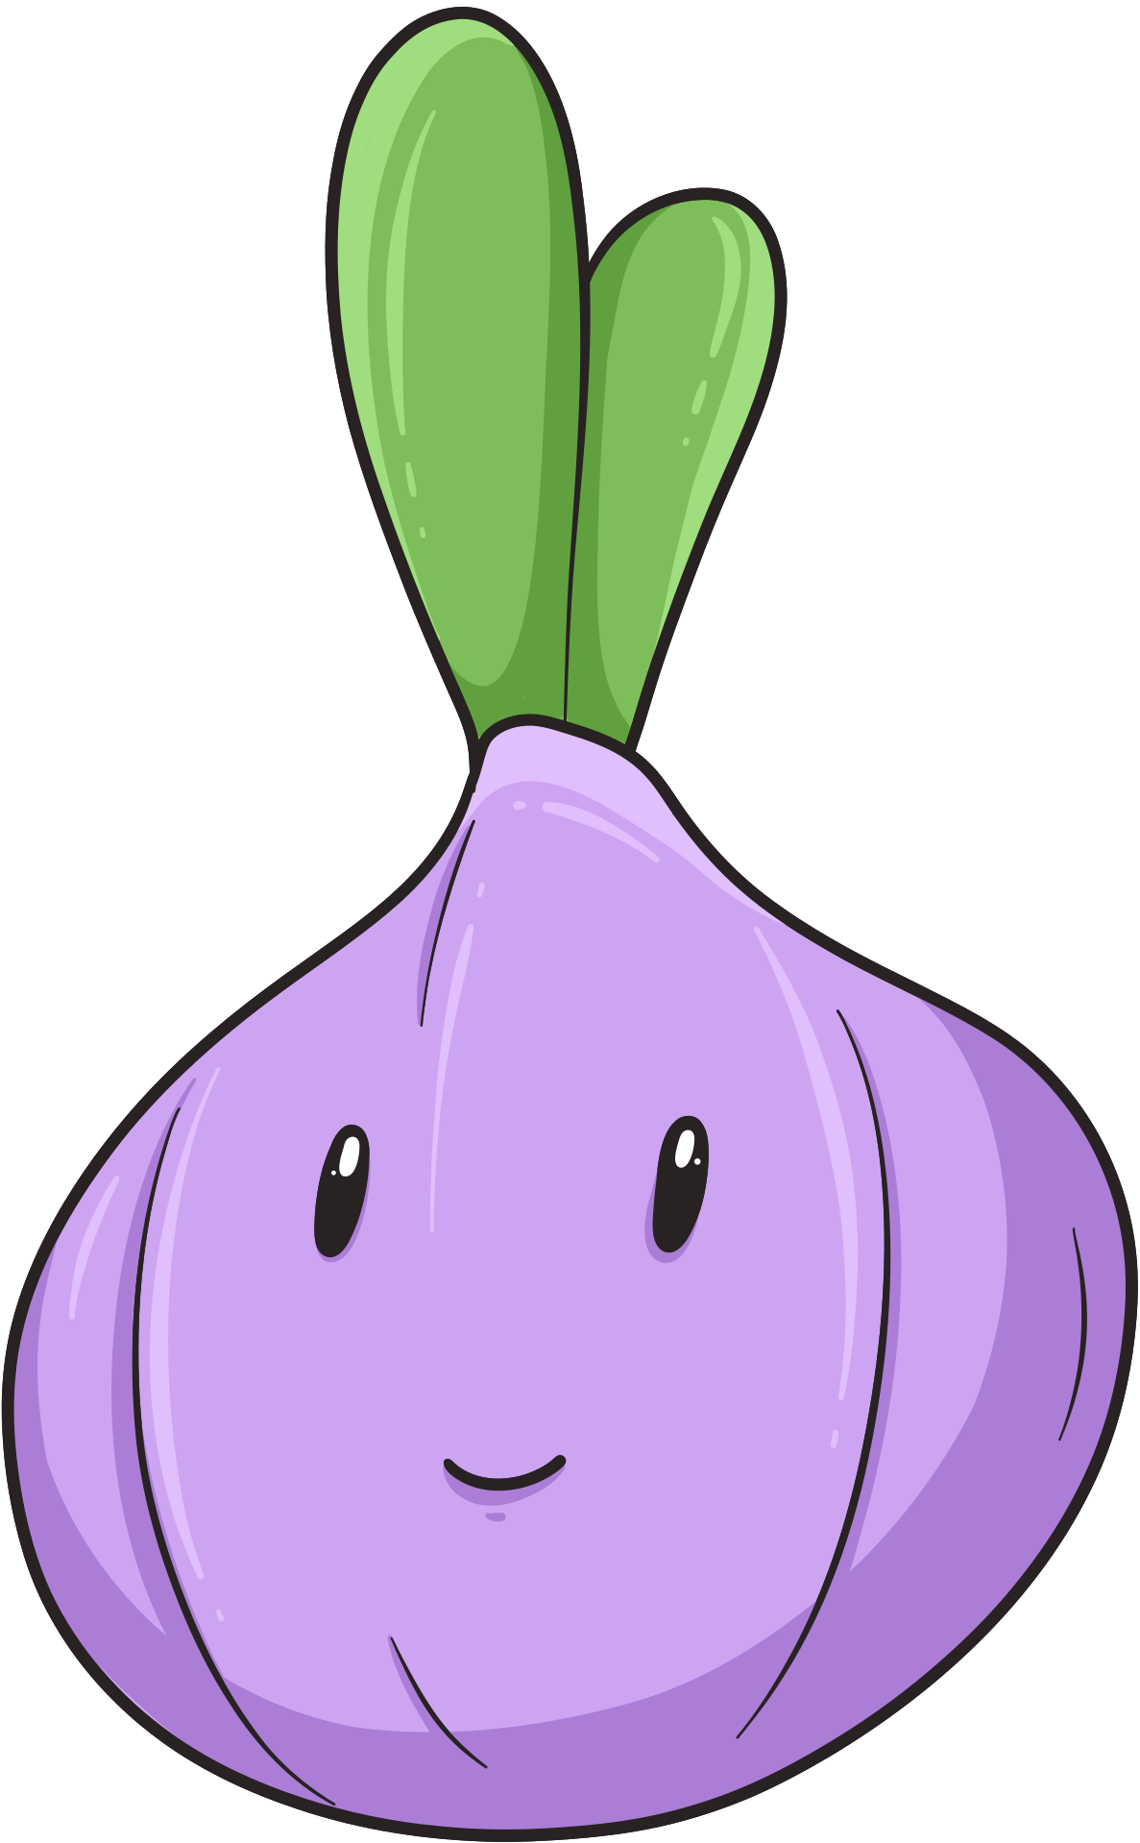




Our Stats
Number of Students: 457
Grades: Kindergarten - Grade 8
Location: Downtown Core, St. Catharines, ON
Location Details: Lots of cultural diversity, low socioeconomic status, many apartment buildings, shelters and mental health/addiction struggles

Slide 3

Our Community
Connaught is a lively school filled with students of diverse backgrounds, beliefs and histories. Many of our families are persevering through challenging circumstances on a daily basis. Our school is full of caring adults who do everything they can to support, care for and encourage our students to reach for success and pave a confident path into their future. We do our best as a school community to offer events and programs for families that are low in cost or free, including movie nights, care packages for winter break, food programs and our school produce market. Only with the support of local organizations and grants, are we able to make this possible. From the bottom of our hearts, thank you for selecting us to receive this grant. Hundreds of families have had fresh produce on their tables - to fill their bellies, fuel their brains and make tough financial times just that much easier. Thank you for believing in us.

Slide 4


Our Story
We started our school produce market last year, with the leadership of Niagara Region Public Health. The program was created by public health nurses to increase food literacy in schools and provide an affordable way for families to access fresh produce. Our school was asked to participate based on our location (not being within walking distance of grocery stores) and having a significant number of students accessing breakfast and lunch food programs.
Our Grade 7 class led the market last year, designed the logo and choose the “Connaught Be More Healthy” name.
This year our Grade 6/7 class led the market, with the support of our Youth Counsellor and reduced support from public health.
The class that leads the market participates in several interactive lessons on topics including advertising, healthy living, budgeting, customer service and community exploration.
Our school is now about to host our 8th market, with a huge thank you to the “nourish to flourish” grant.
*Our school did apply for two grants ($1000 for our breakfast program and $3000 for the market). We received the $3000 grant with the understanding that a portion of it would support our breakfast program in purchasing a new fridge.

Slide 5
Key Features of the Connaught Be More Healthy School Produce Market
Families can purchase fresh produce bags for $5 a bag or purchase a bag to pay it forward to other families in our school community.
Lococo’s has partnered with the school produce markets to offer us bulk pricing, which means the more bags that are ordered, the more produce each bag has in it!
A class is chosen each year to host the market. This year our Grade 6/7 class hosted. The class participates in lessons prior to the actual markets. These lessons include: community health, customer service, advertising, budgeting, local produce and its availability each season.
The class also chooses what produce items go in each bag and whether we can afford each type of produce.
Thanks to this grant, we were able to top up our bags with extra produce and better support our school community with more free produce tastings and produce bags, as well as, purchase some new equipment for our breakfast program.

Slide 6
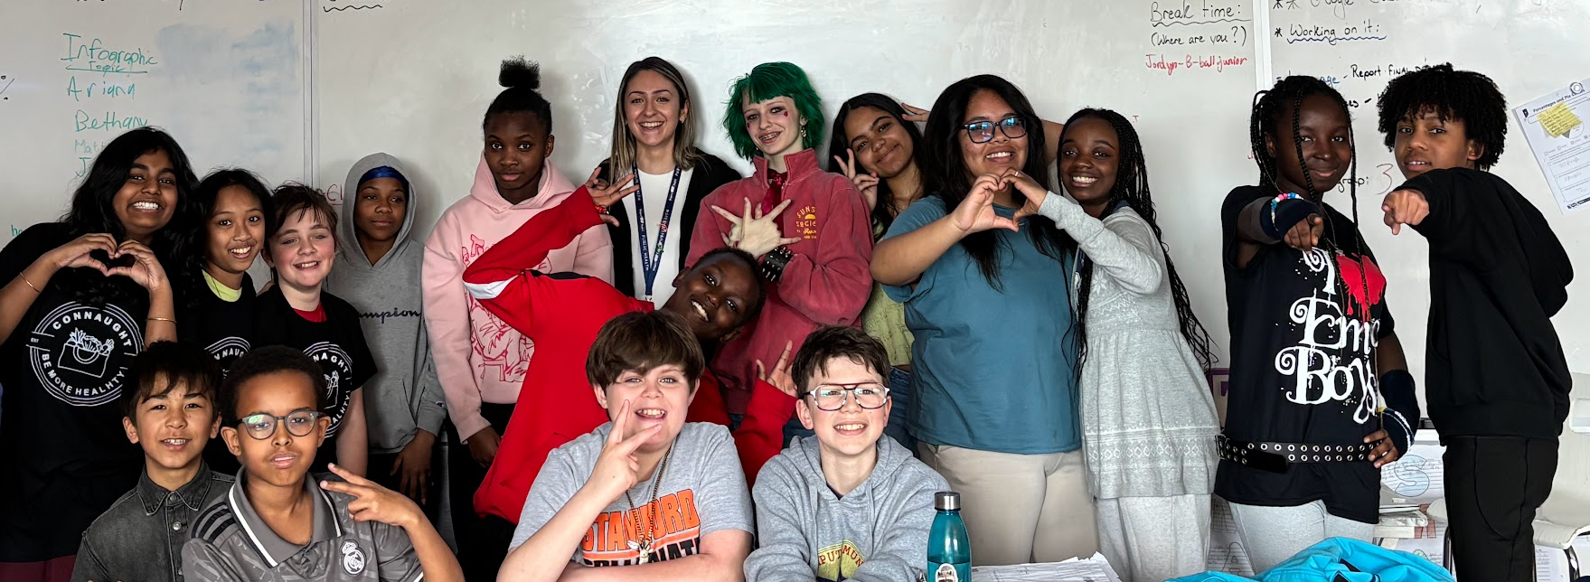
Our Market Team

Slide 7

How it Starts
Families order their $5 produce bags through School Cash Online. Many pay it forward bags are purchased as well! The pay it forward bags are distributed to families anonymously.

Slide 8
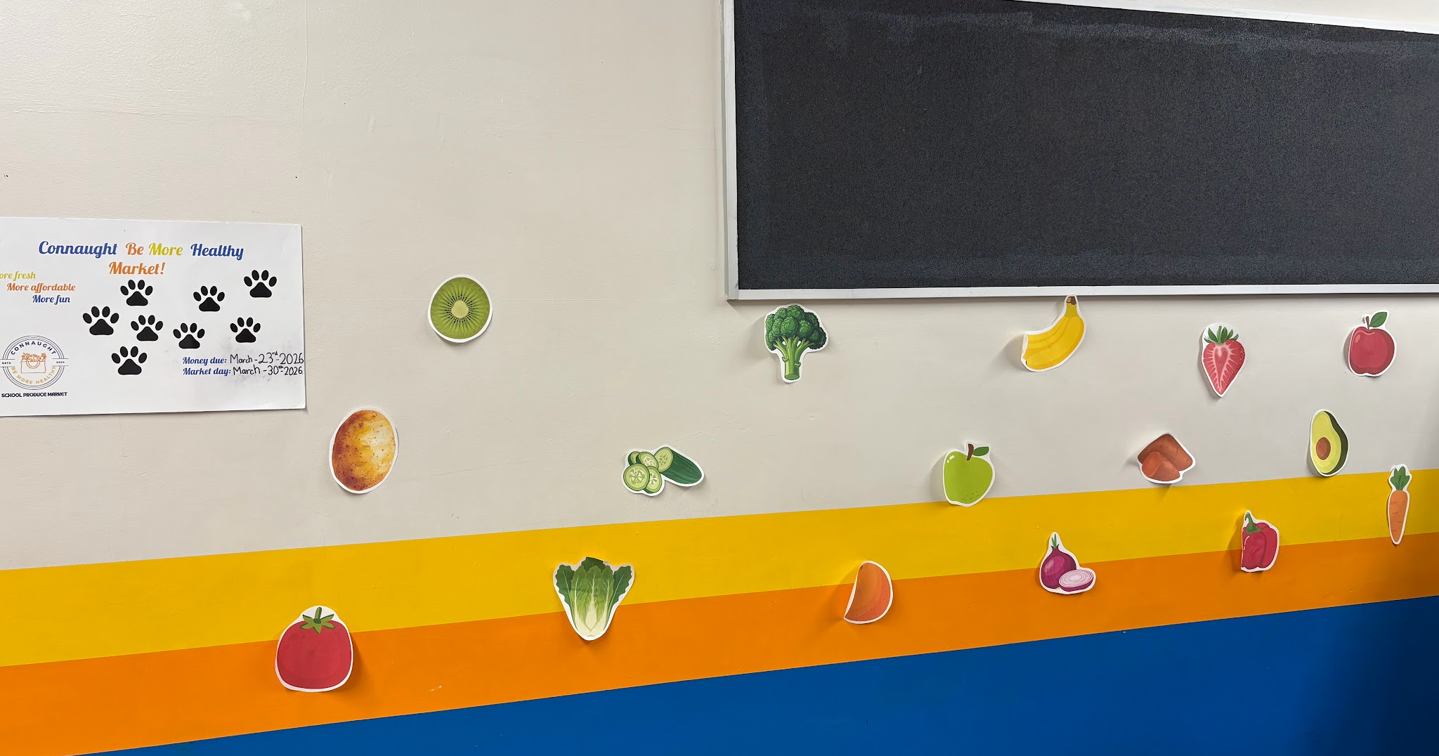
We hosted a student vote for most preferred produce…

Slide 9
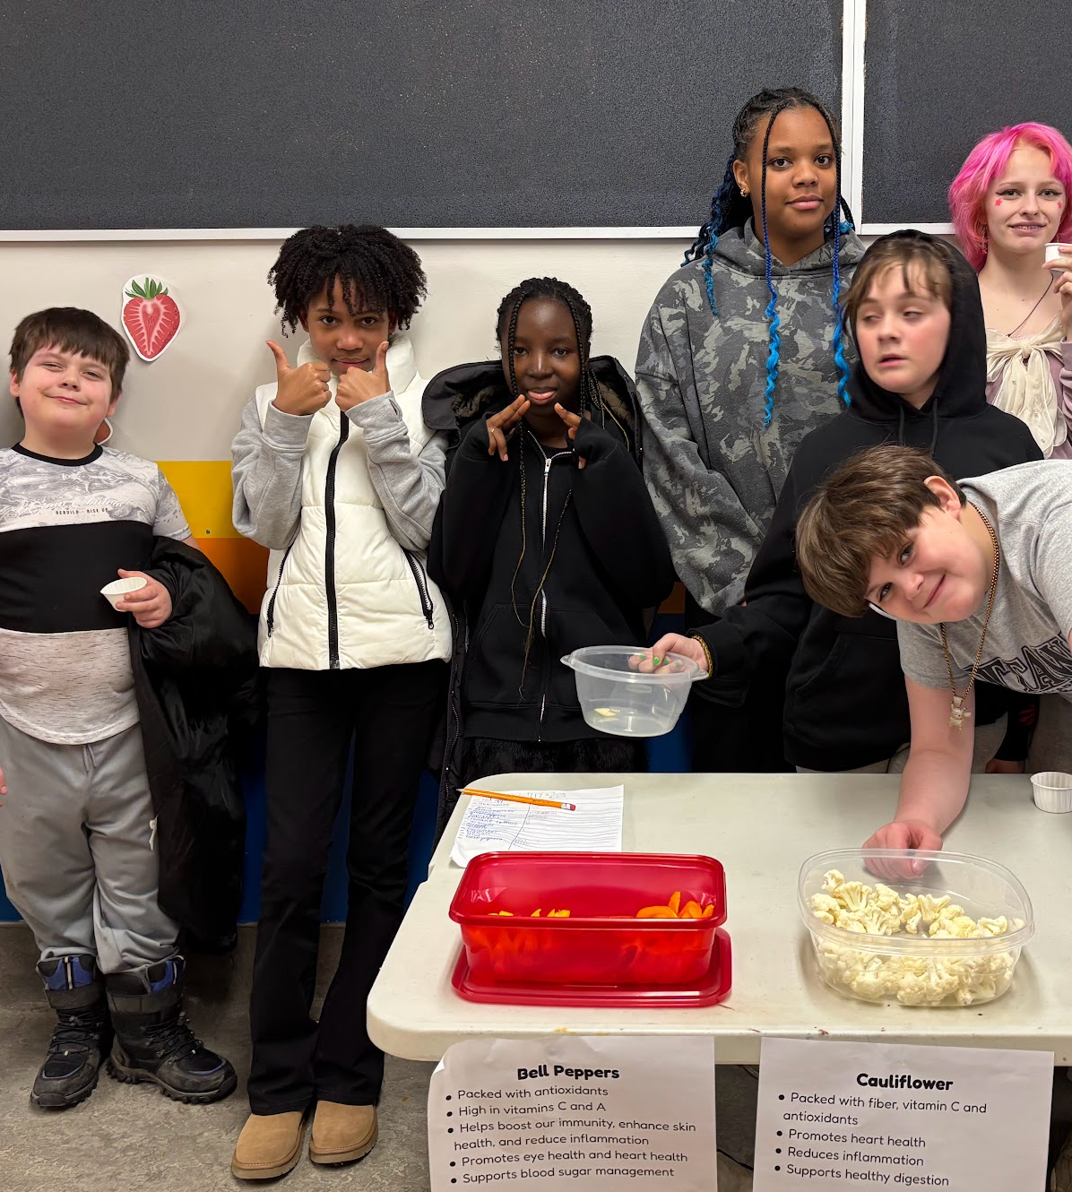

And of course offered lots of produce nutrition facts and some yummy produce for tasting too!

Slide 10

Once orders are closed, the class sits down to see what budget they have for the produce bags. The base budget is $5 x # of bags sold.
Then they determine how much money is needed to “top up” the bags in ensure that each bag has at least 8 produce items in it and a grocery store value of at least $20.

Slide 11
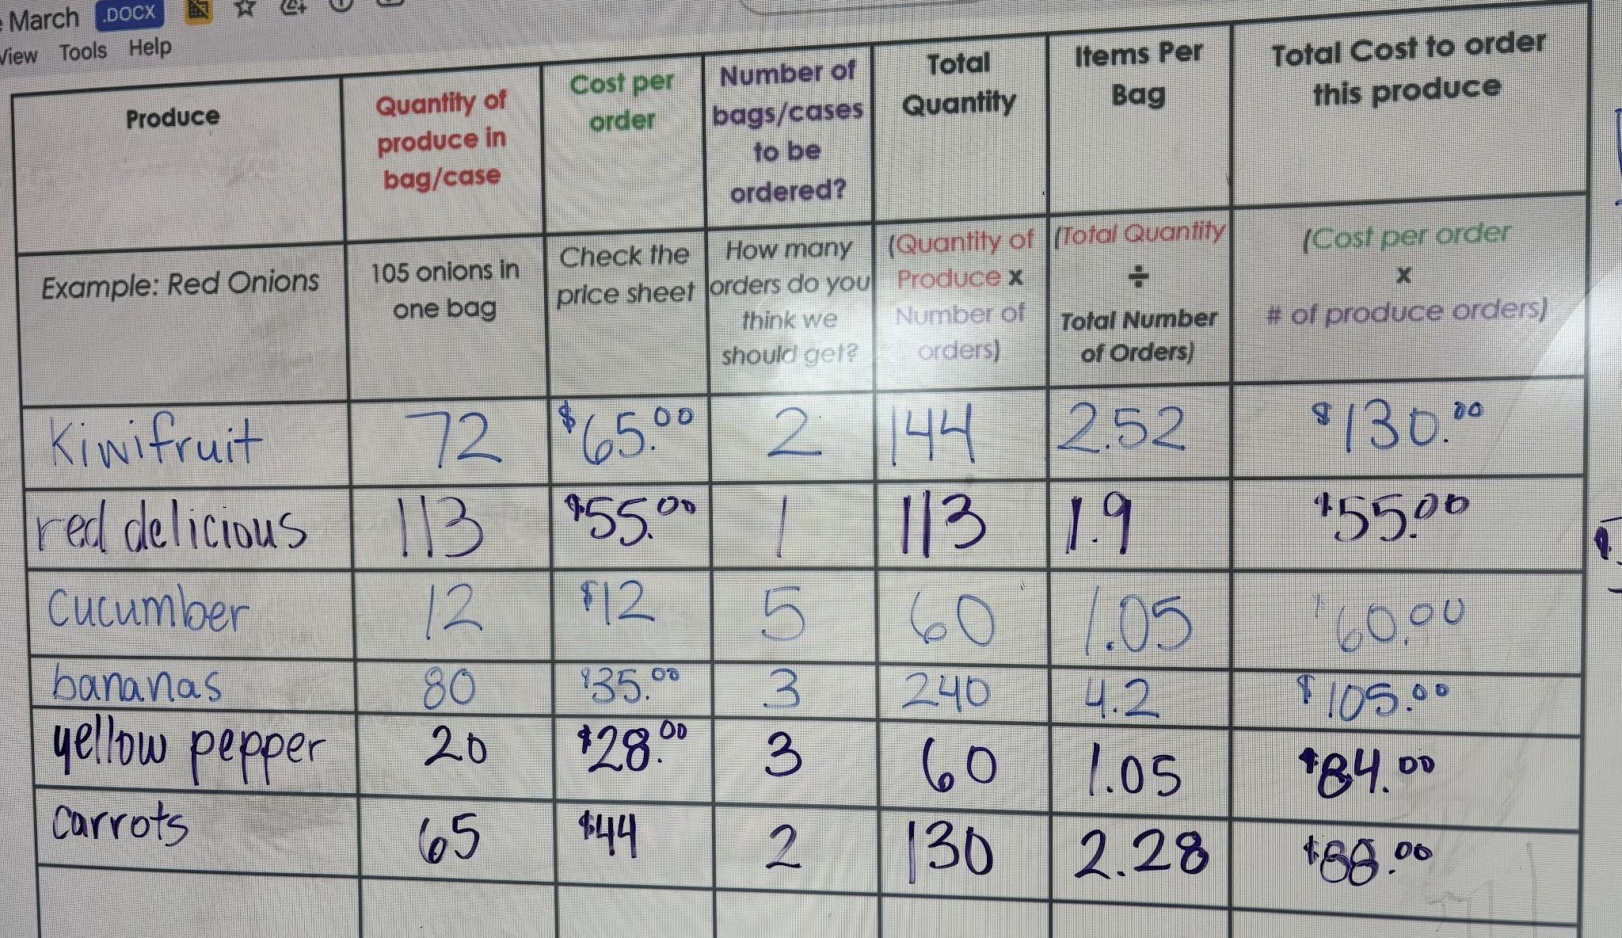
Then the number crunching and ordering happens

Slide 12
About a week later…

Slide 13
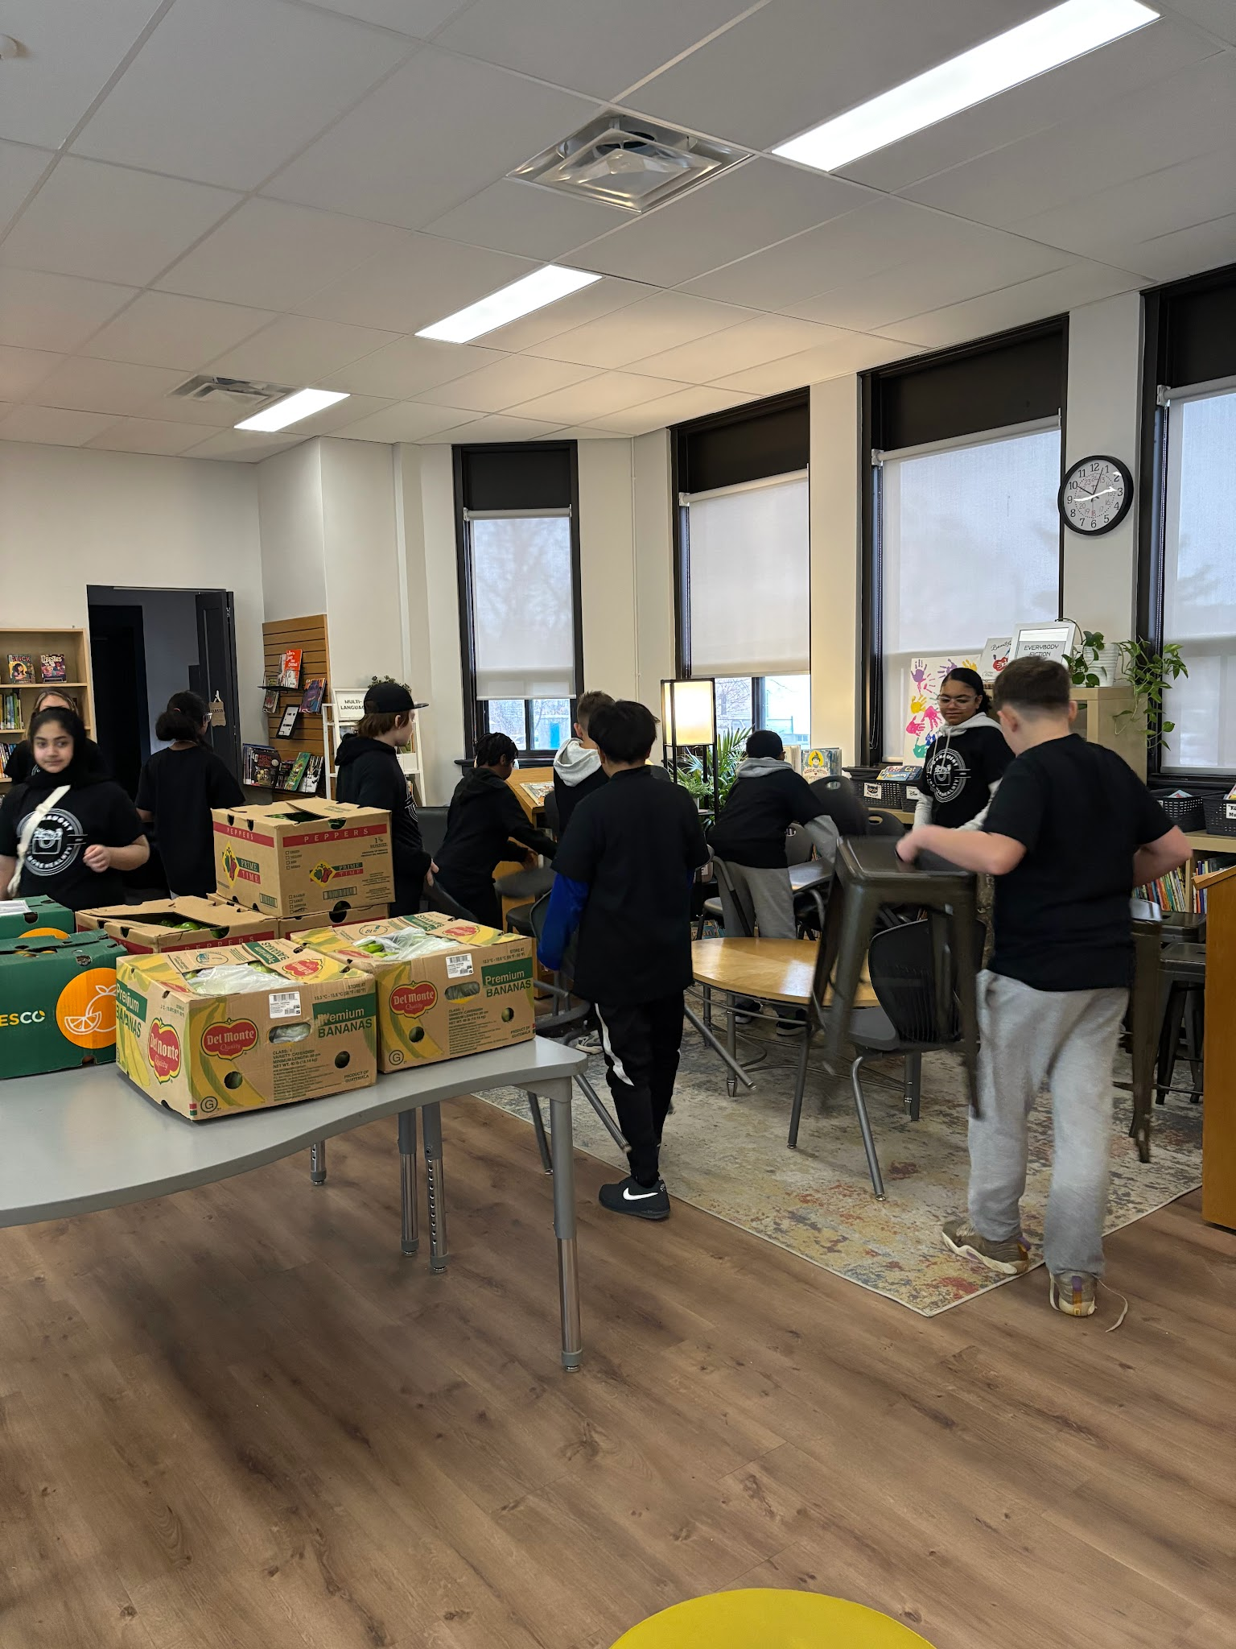
Students set up the library to become a fresh produce market

Slide 14
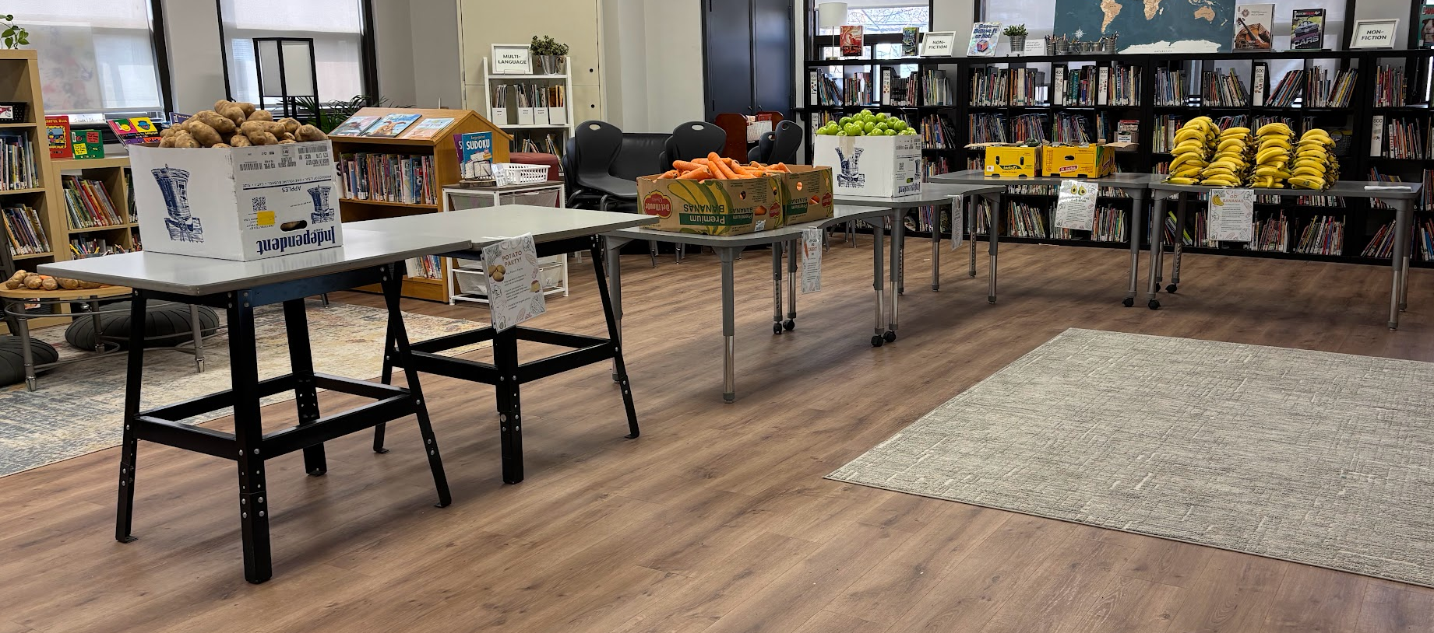
All Set!

Slide 15
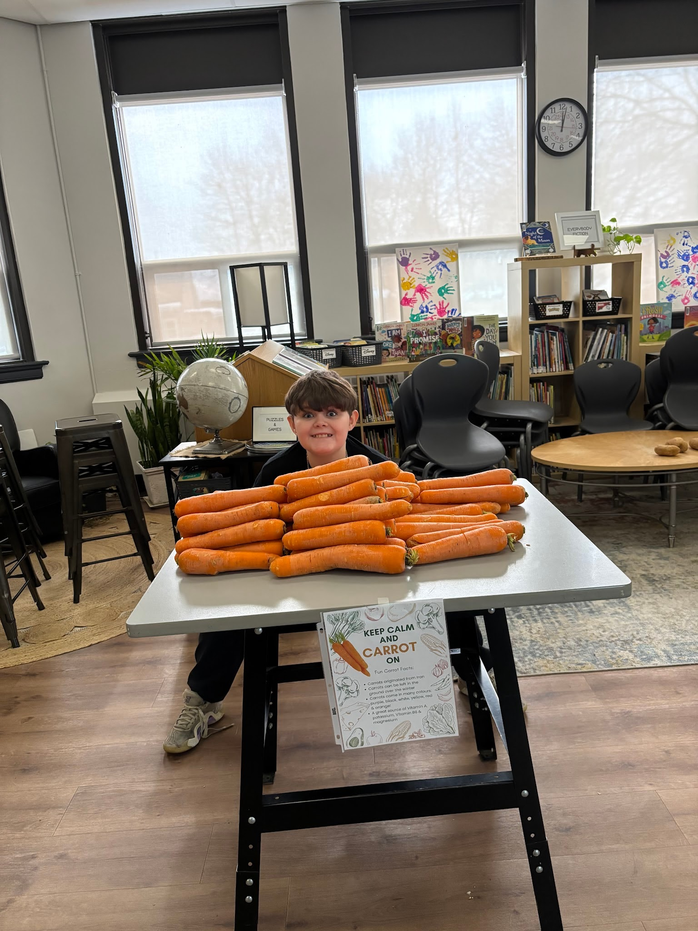
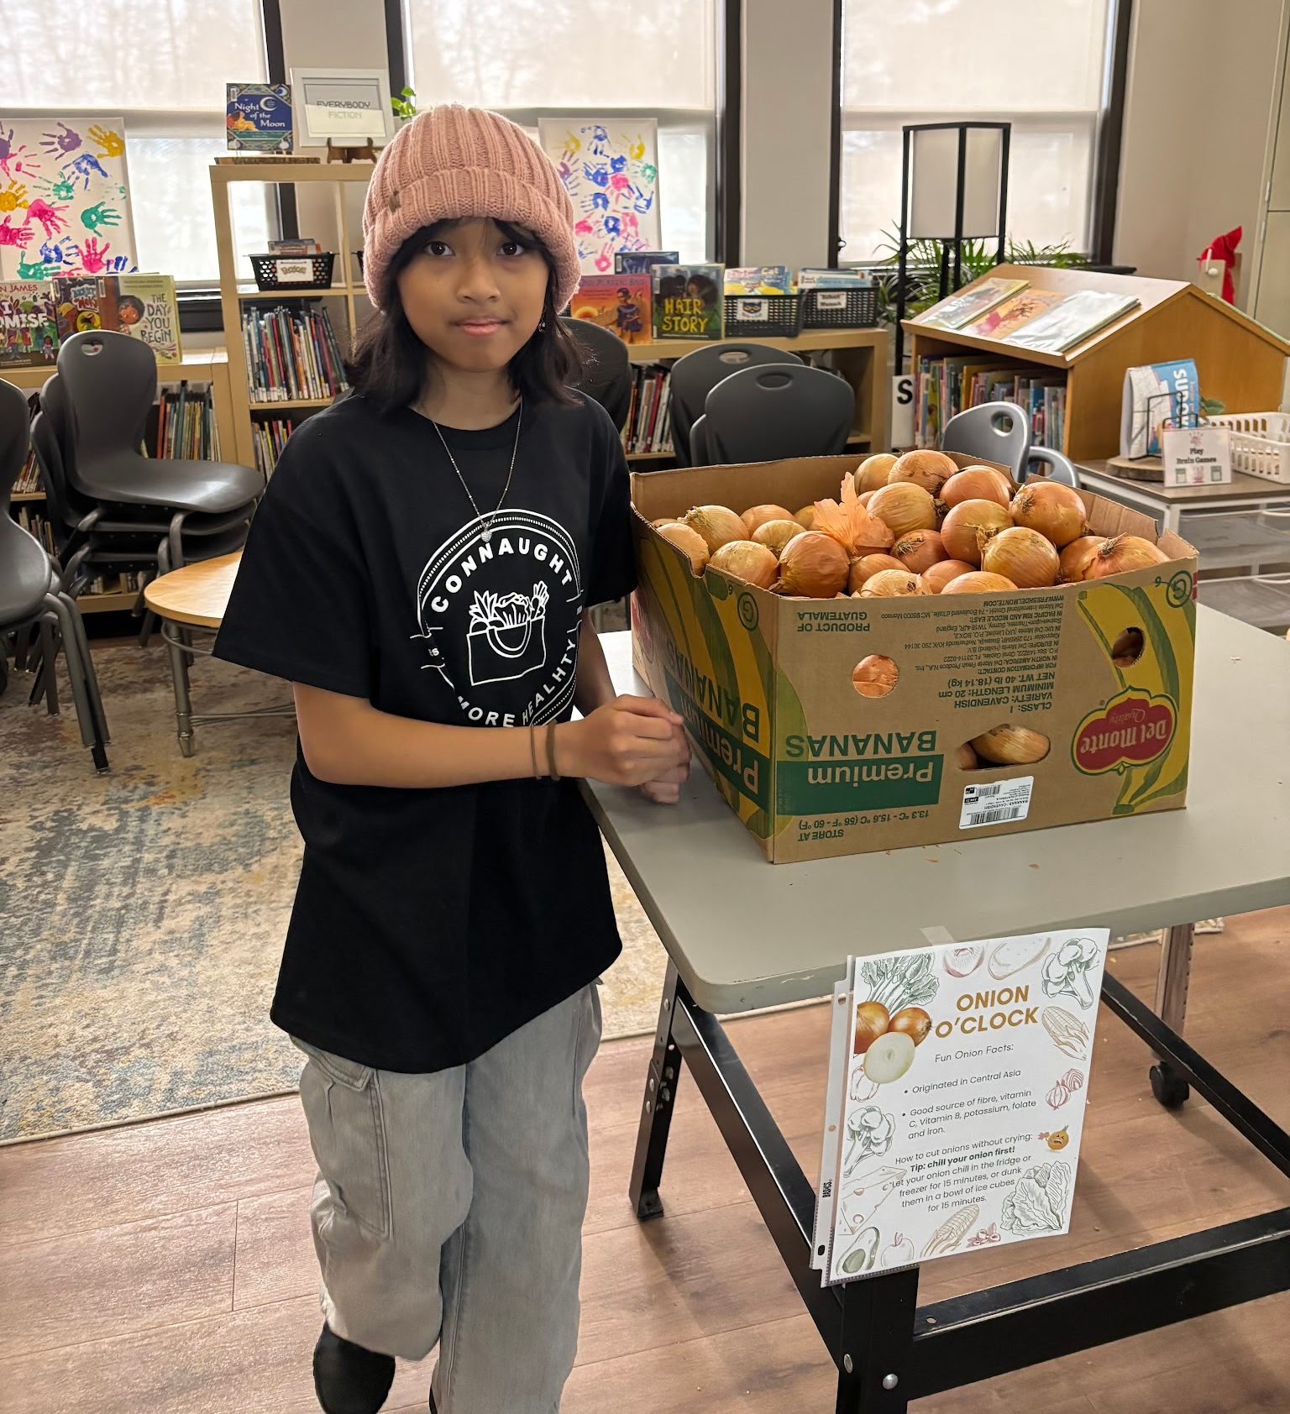

Slide 16
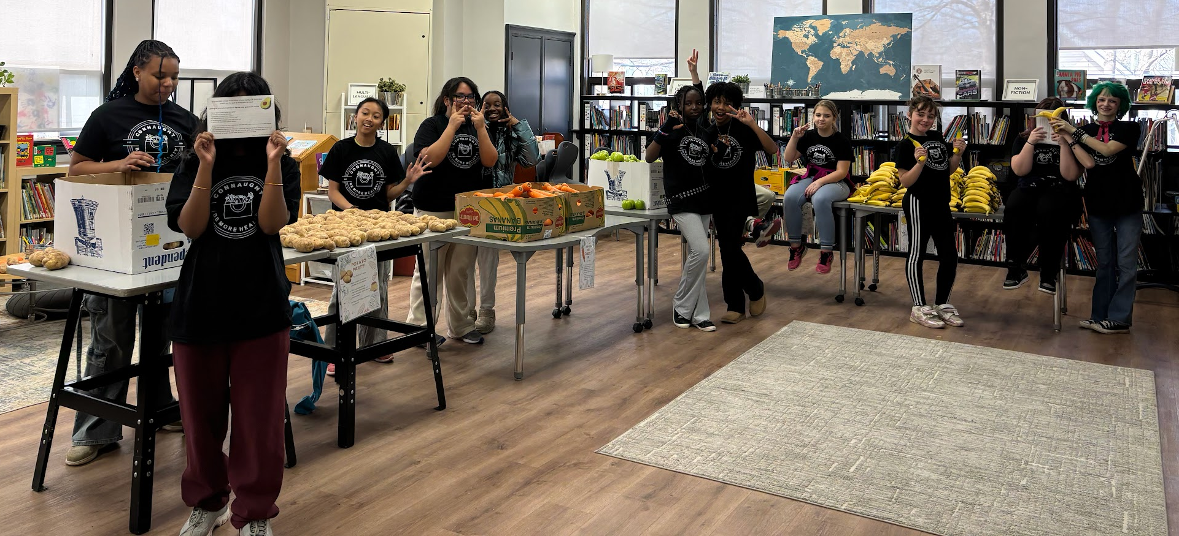

Slide 17

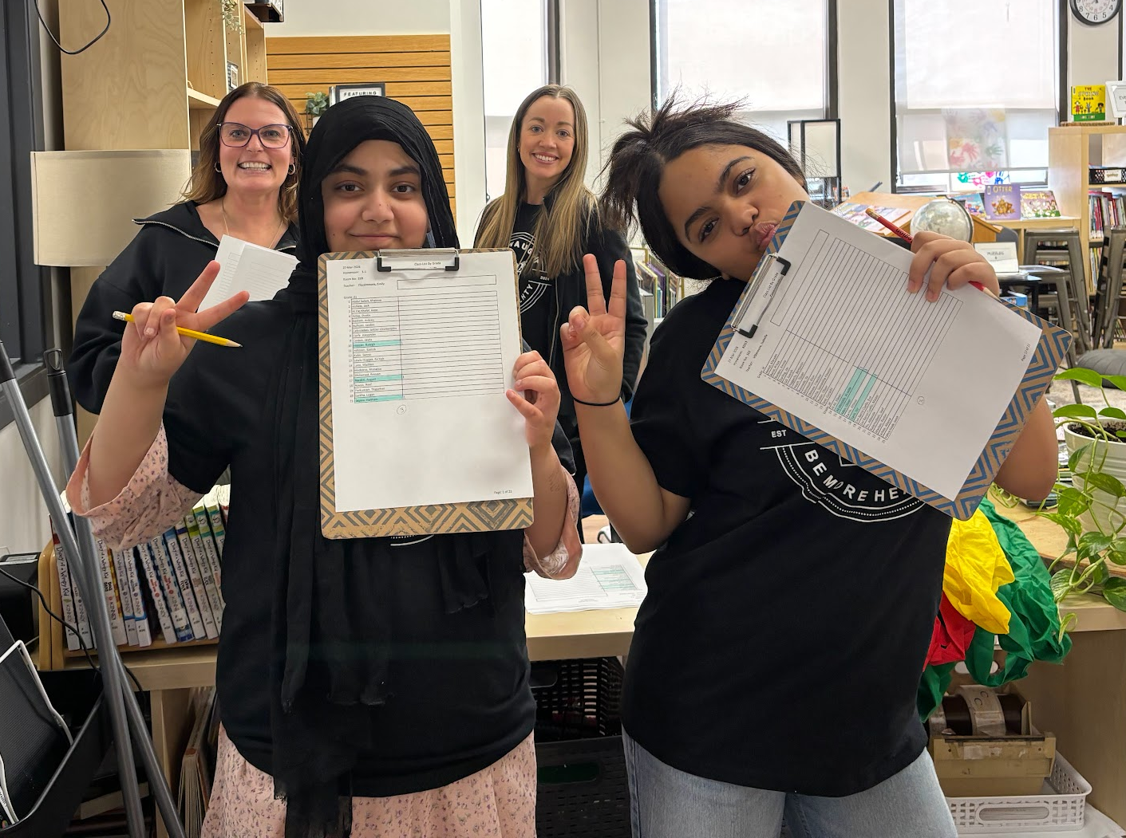
Students are greeted by our check-in team

Slide 18
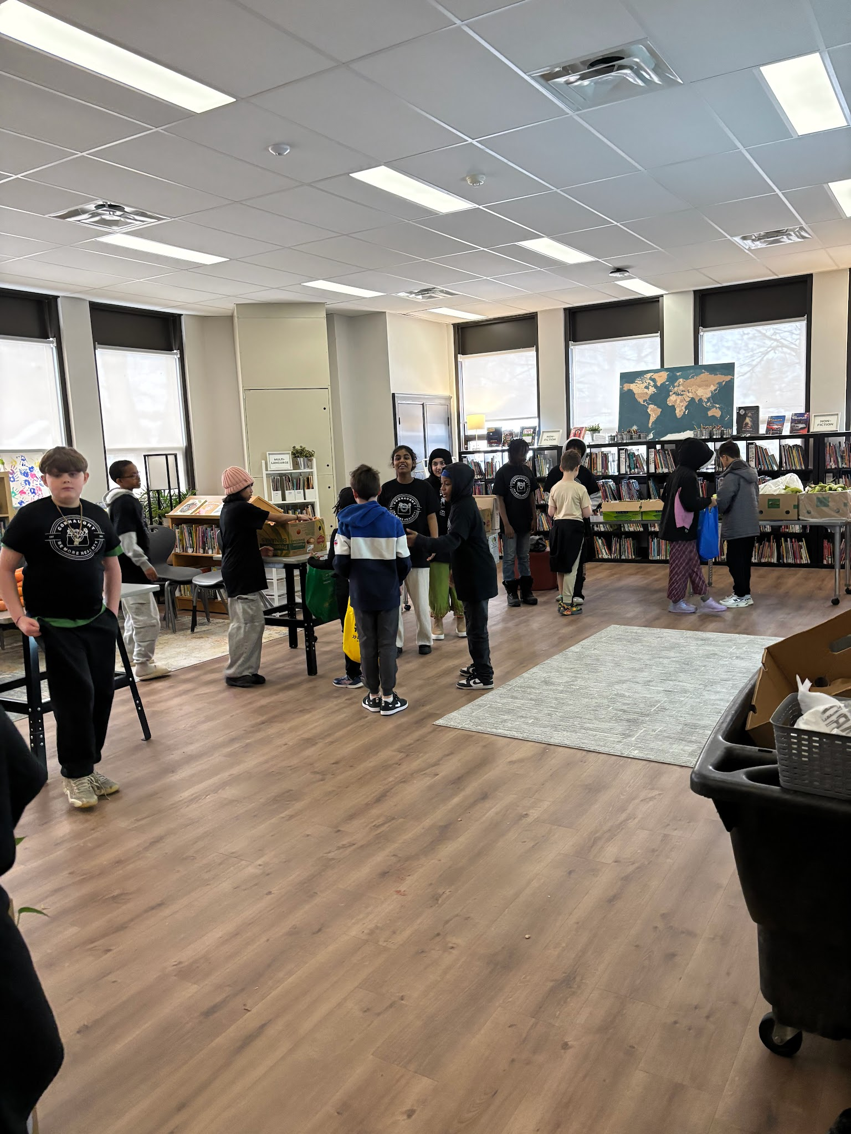
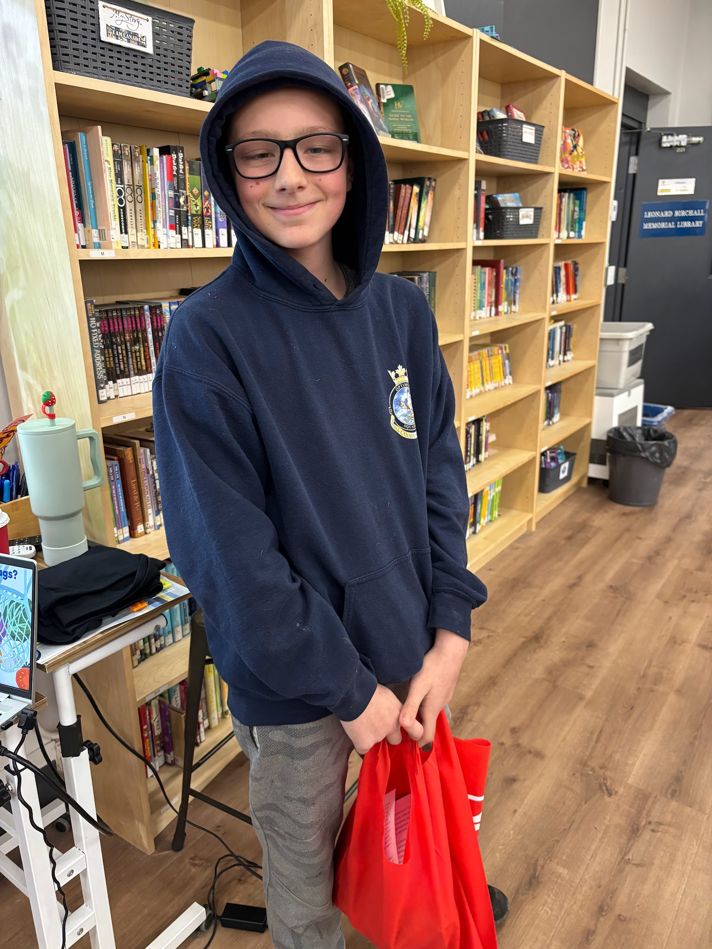
And are welcomed in to shop the market

Slide 19
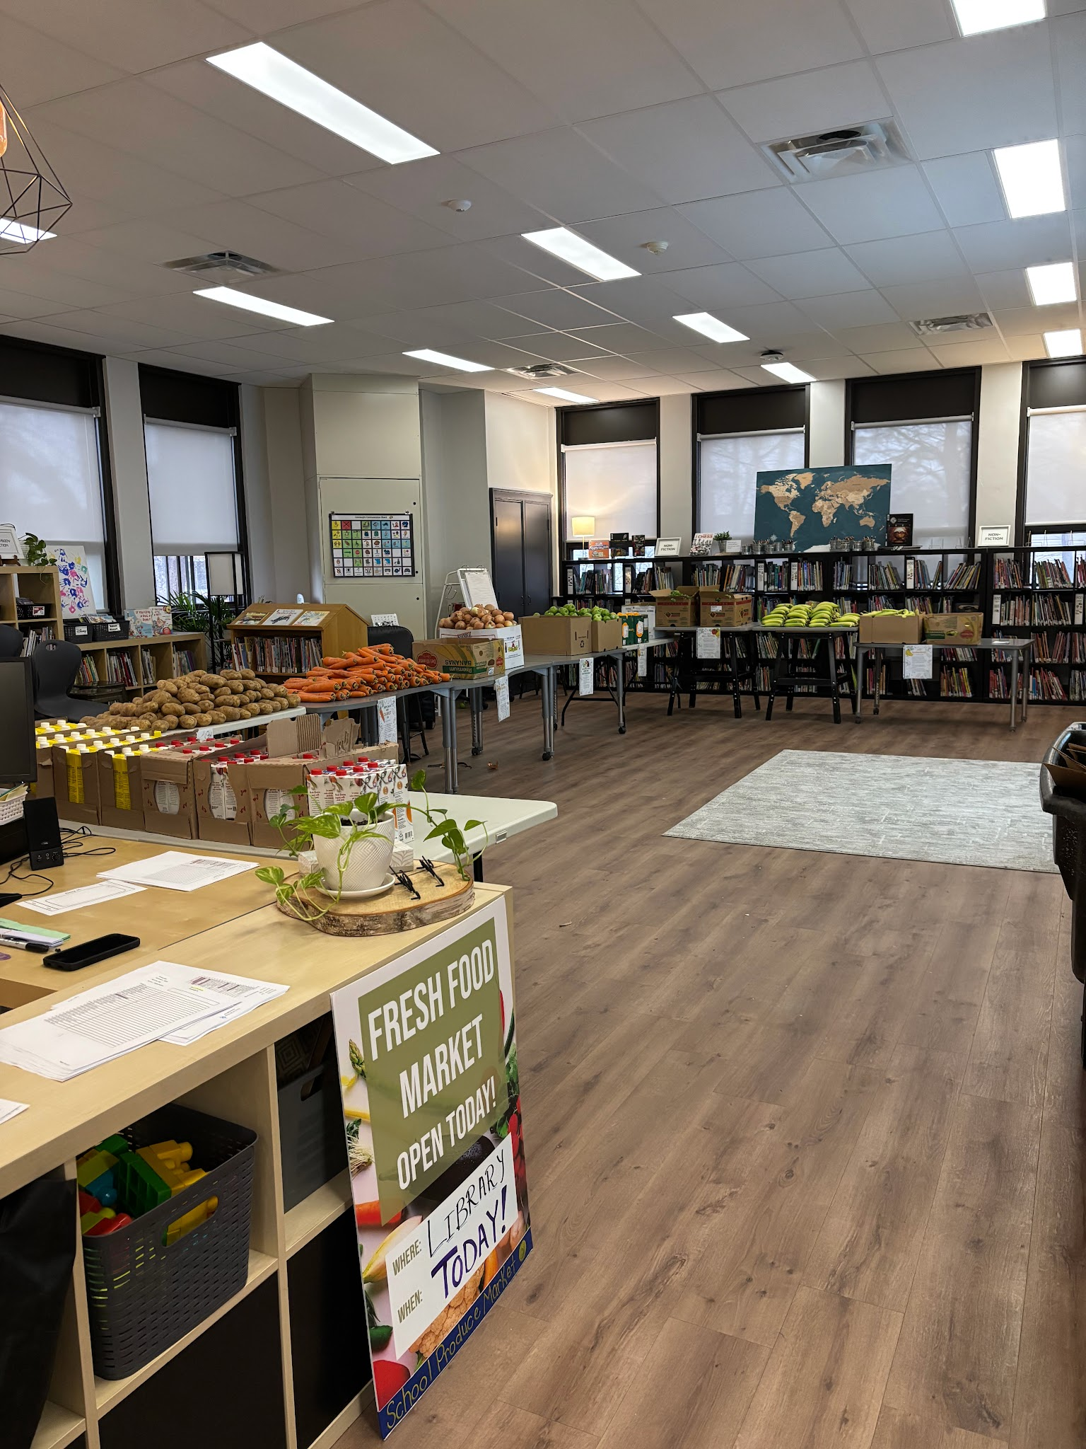


Slide 20
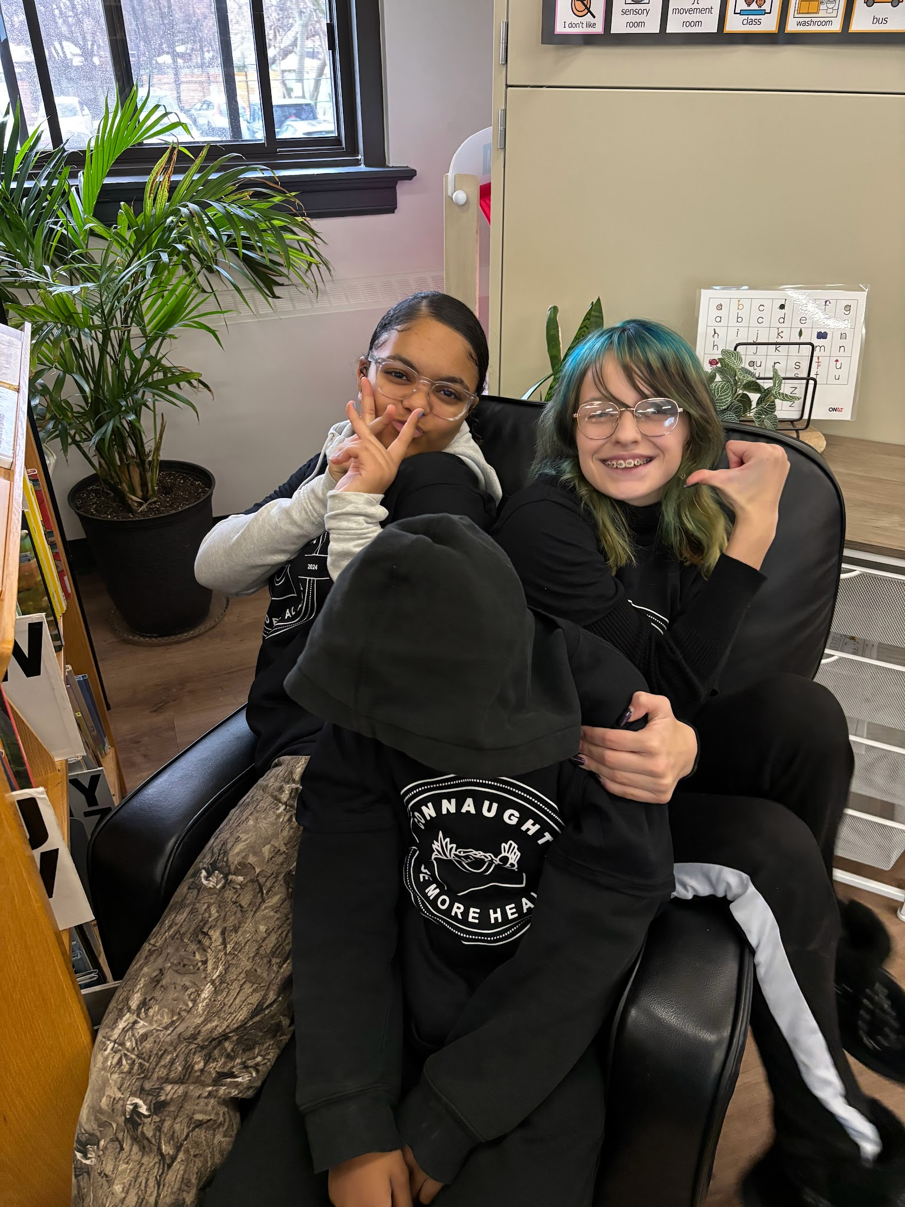
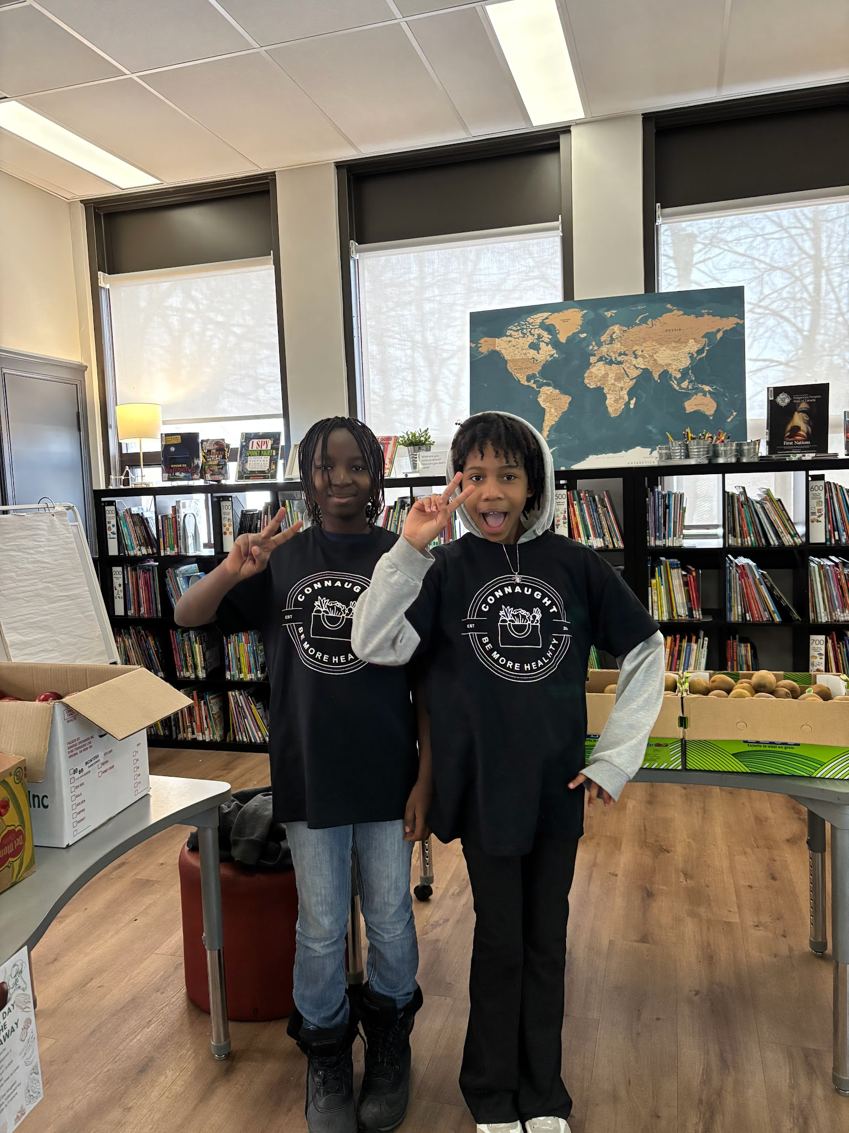
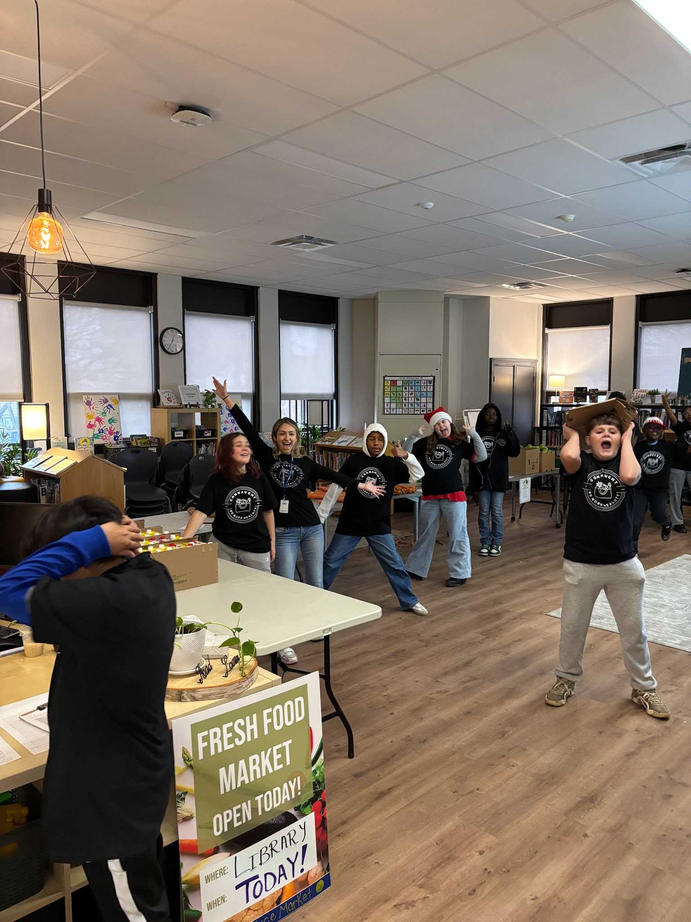
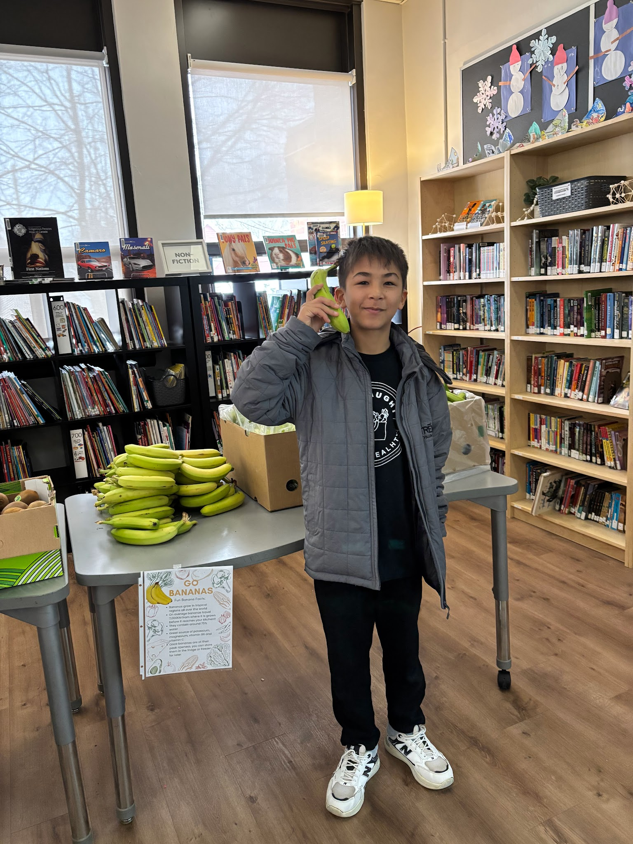
We try to have some fun as well!

Slide 21
The Impact
“I just wanted to share how much our family loves the School Produce Market! My daughter gets so excited when she comes home from school with her bag. She’s always curious to see what’s inside and loves helping decide how we’re going to prepare the different foods.
We appreciate how it encourages her to try new fruits and vegetables that she might otherwise be disinterested in.
It has sparked so much curiosity about food and has created some really fun family moments in the kitchen. We truly enjoy it so much!”
-Kindergarten Mom

Slide 22
The Impact
“Our produce markets have helped educate our community on nutrition, where nutrition is often lacking. Our families’ responses to free or affordable produce reminds us that eating healthy is not cheap.”
-Proud Principal, Mr. Harley

Slide 23
The Impact
By receiving the “nourish to flourish” grant this year we were able to serve salads, fruits and vegetables to our school community at our annual “Family Movie Night.” The look of joy on parents faces after asking if the produce was free and my response of “Yes!” was so memorable. We were able to promote our produce market and educate families about the positive health impacts of the produce we prepared. The next few slides share how the produce was received by families!

Slide 24
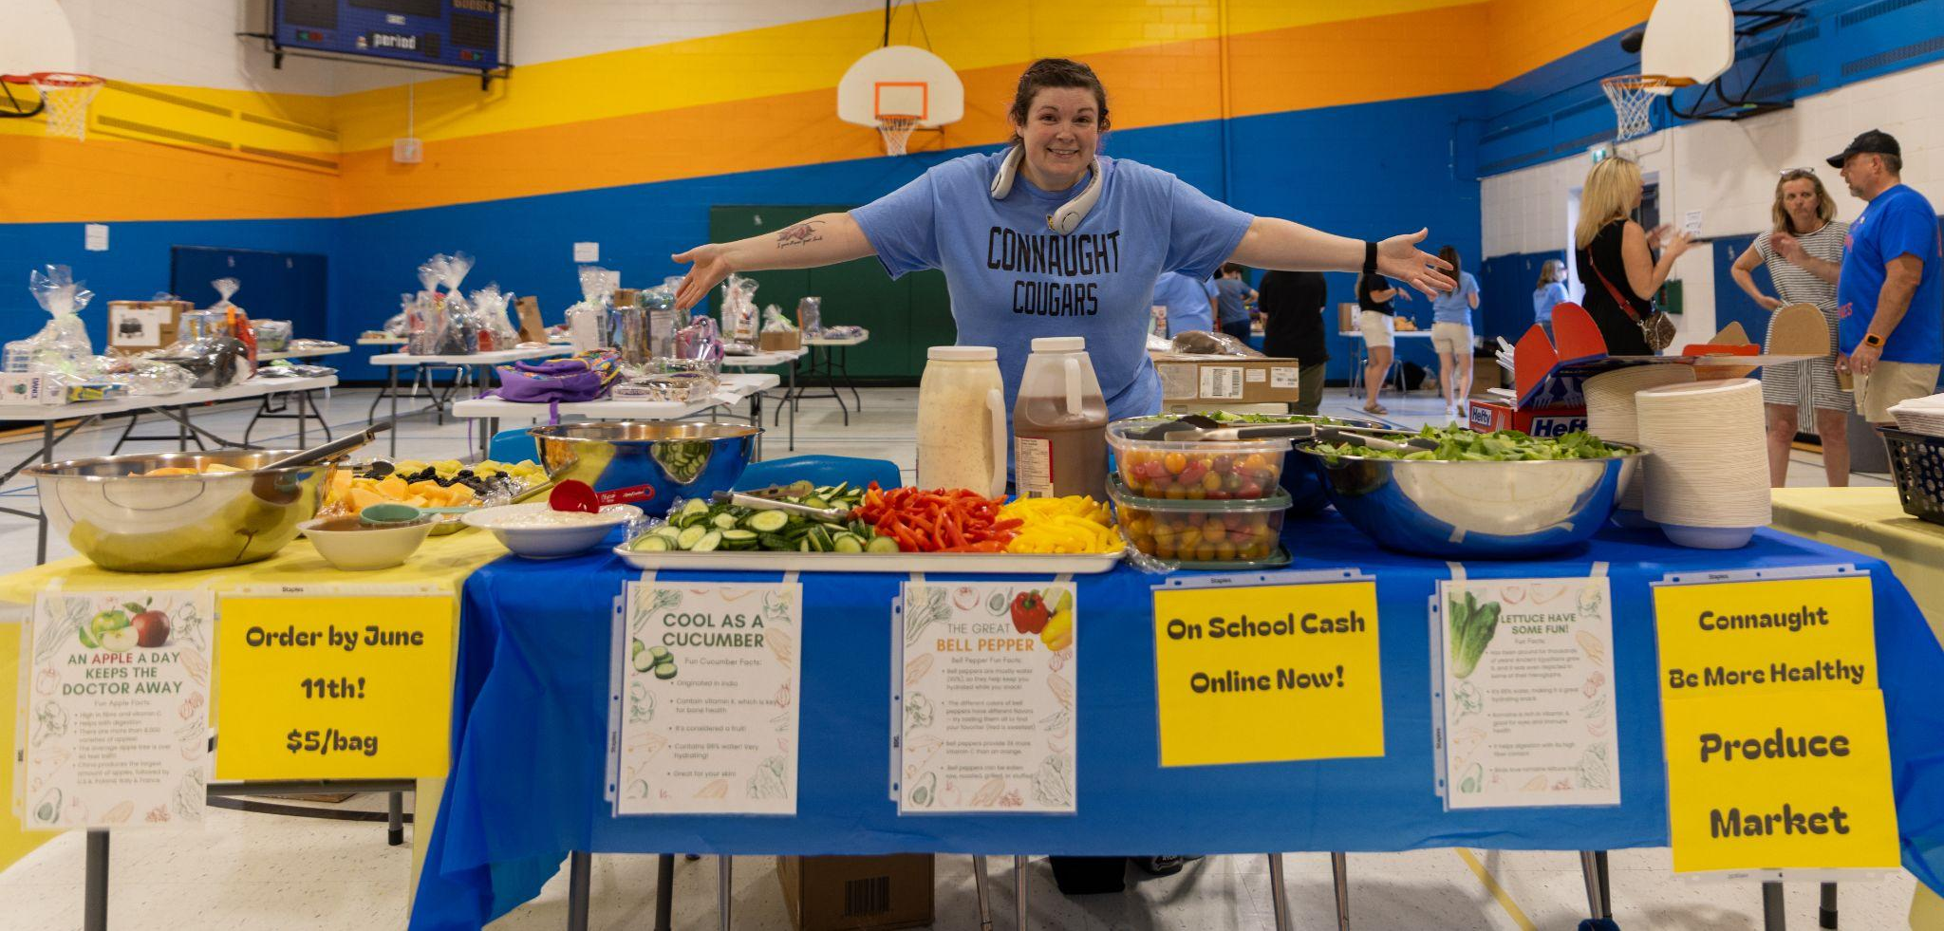
The Impact

Slide 25
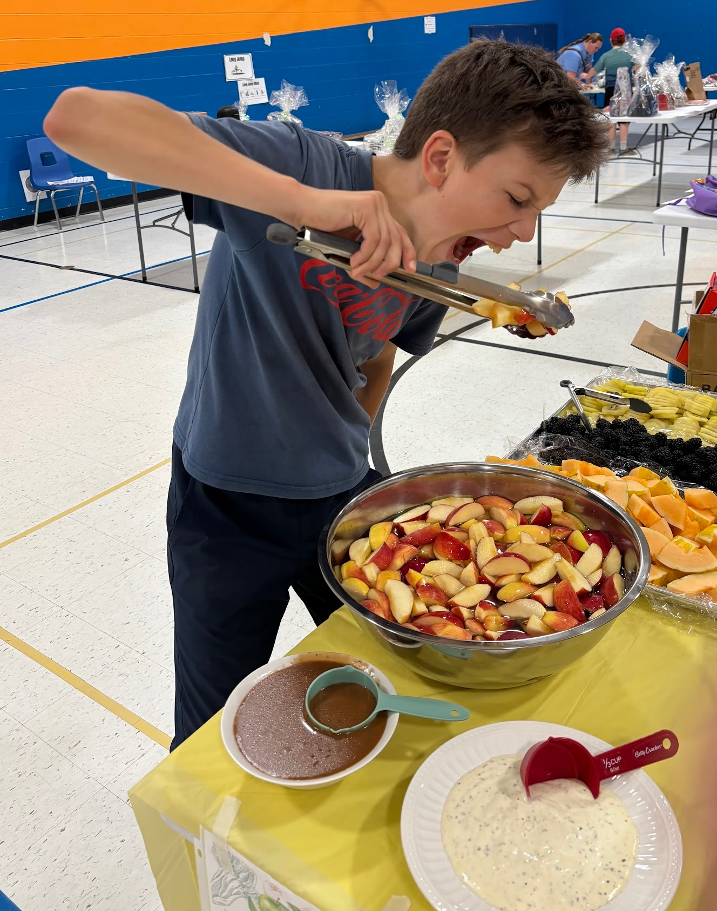
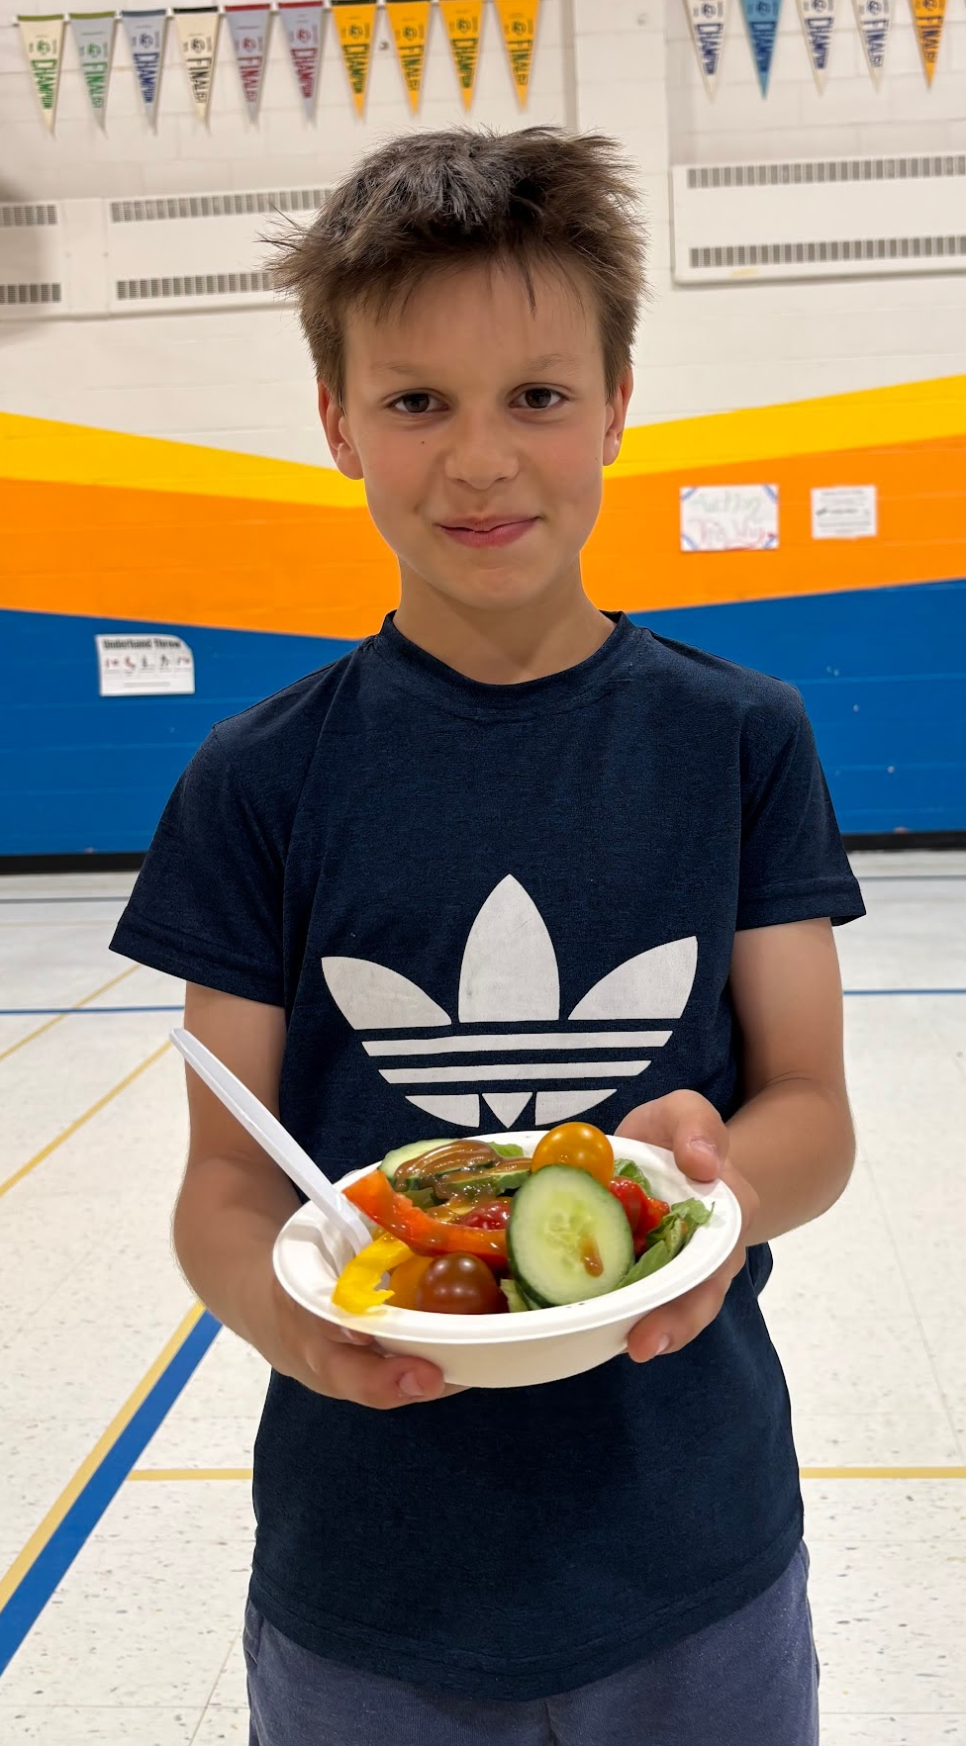
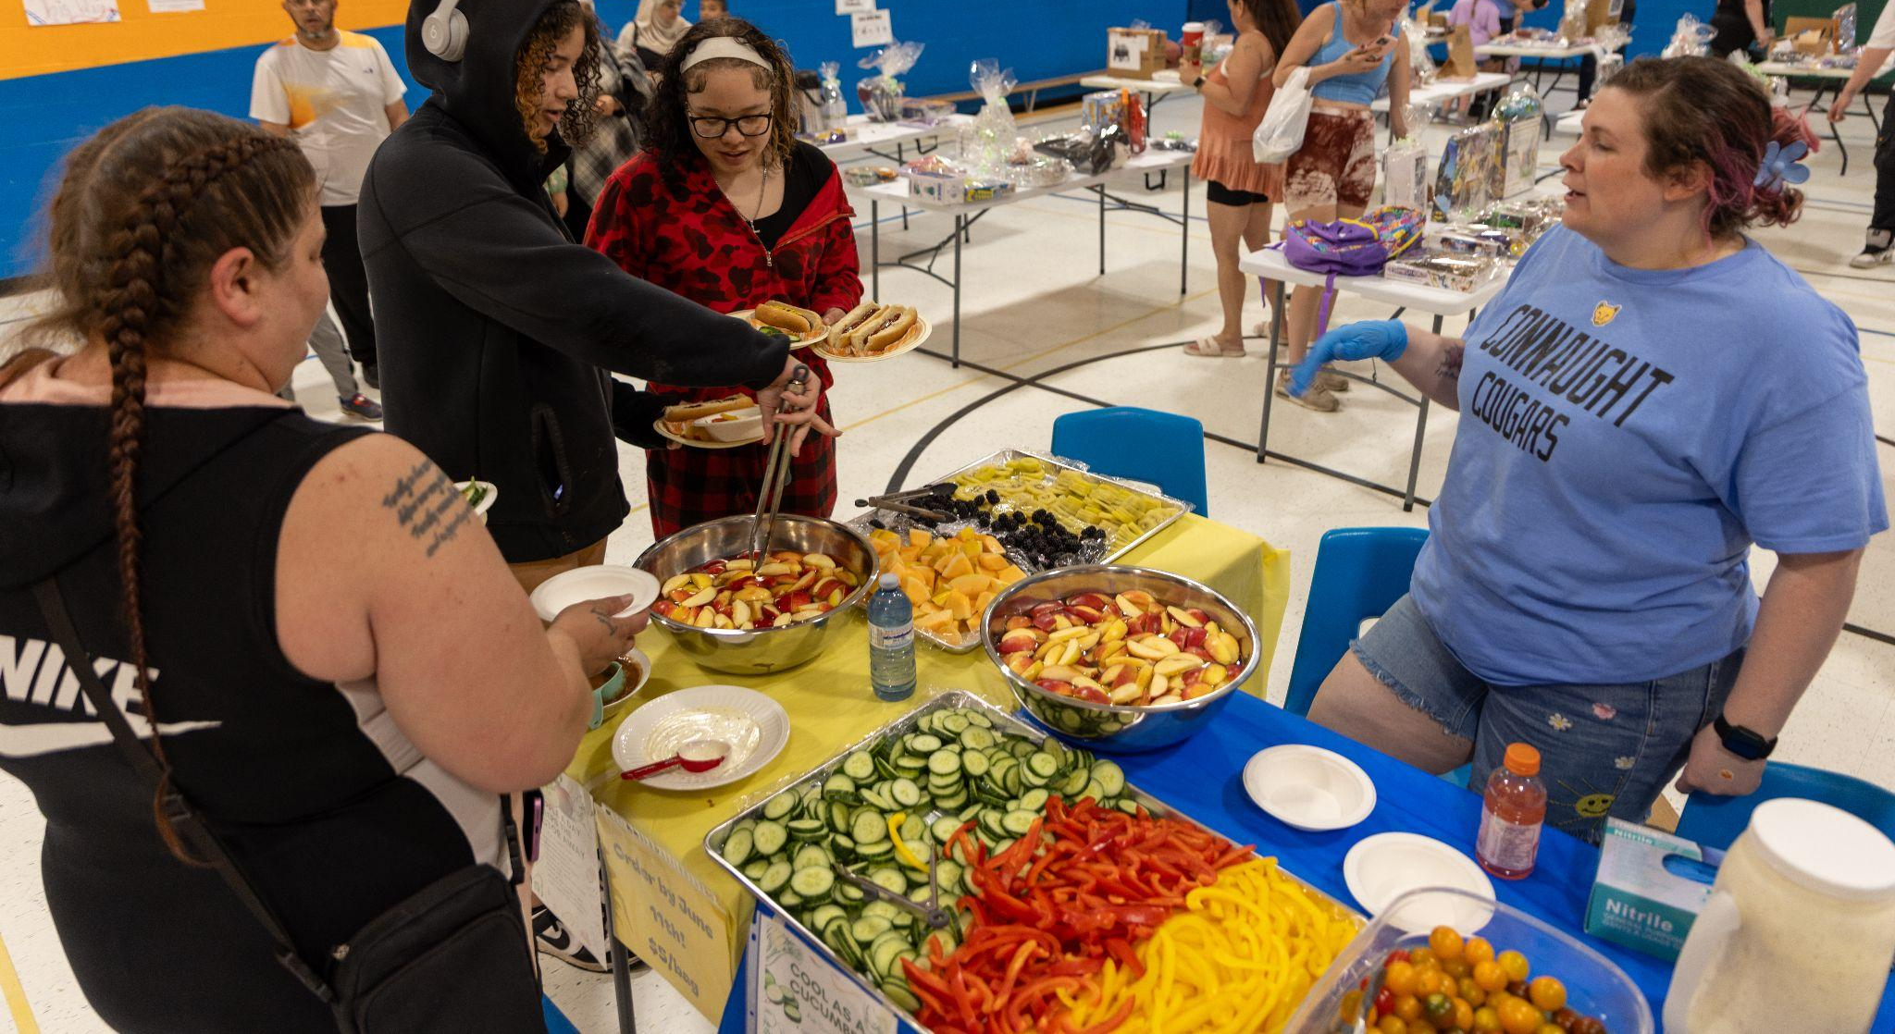
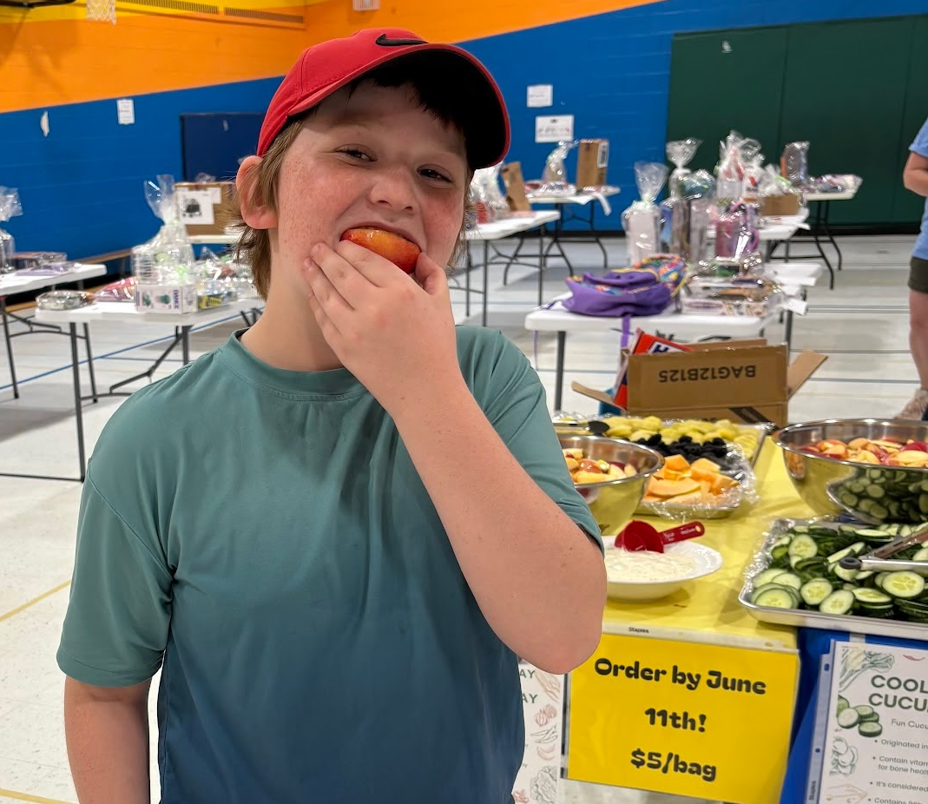
The Impact
Look at that colourful and delicious salad!

Slide 26
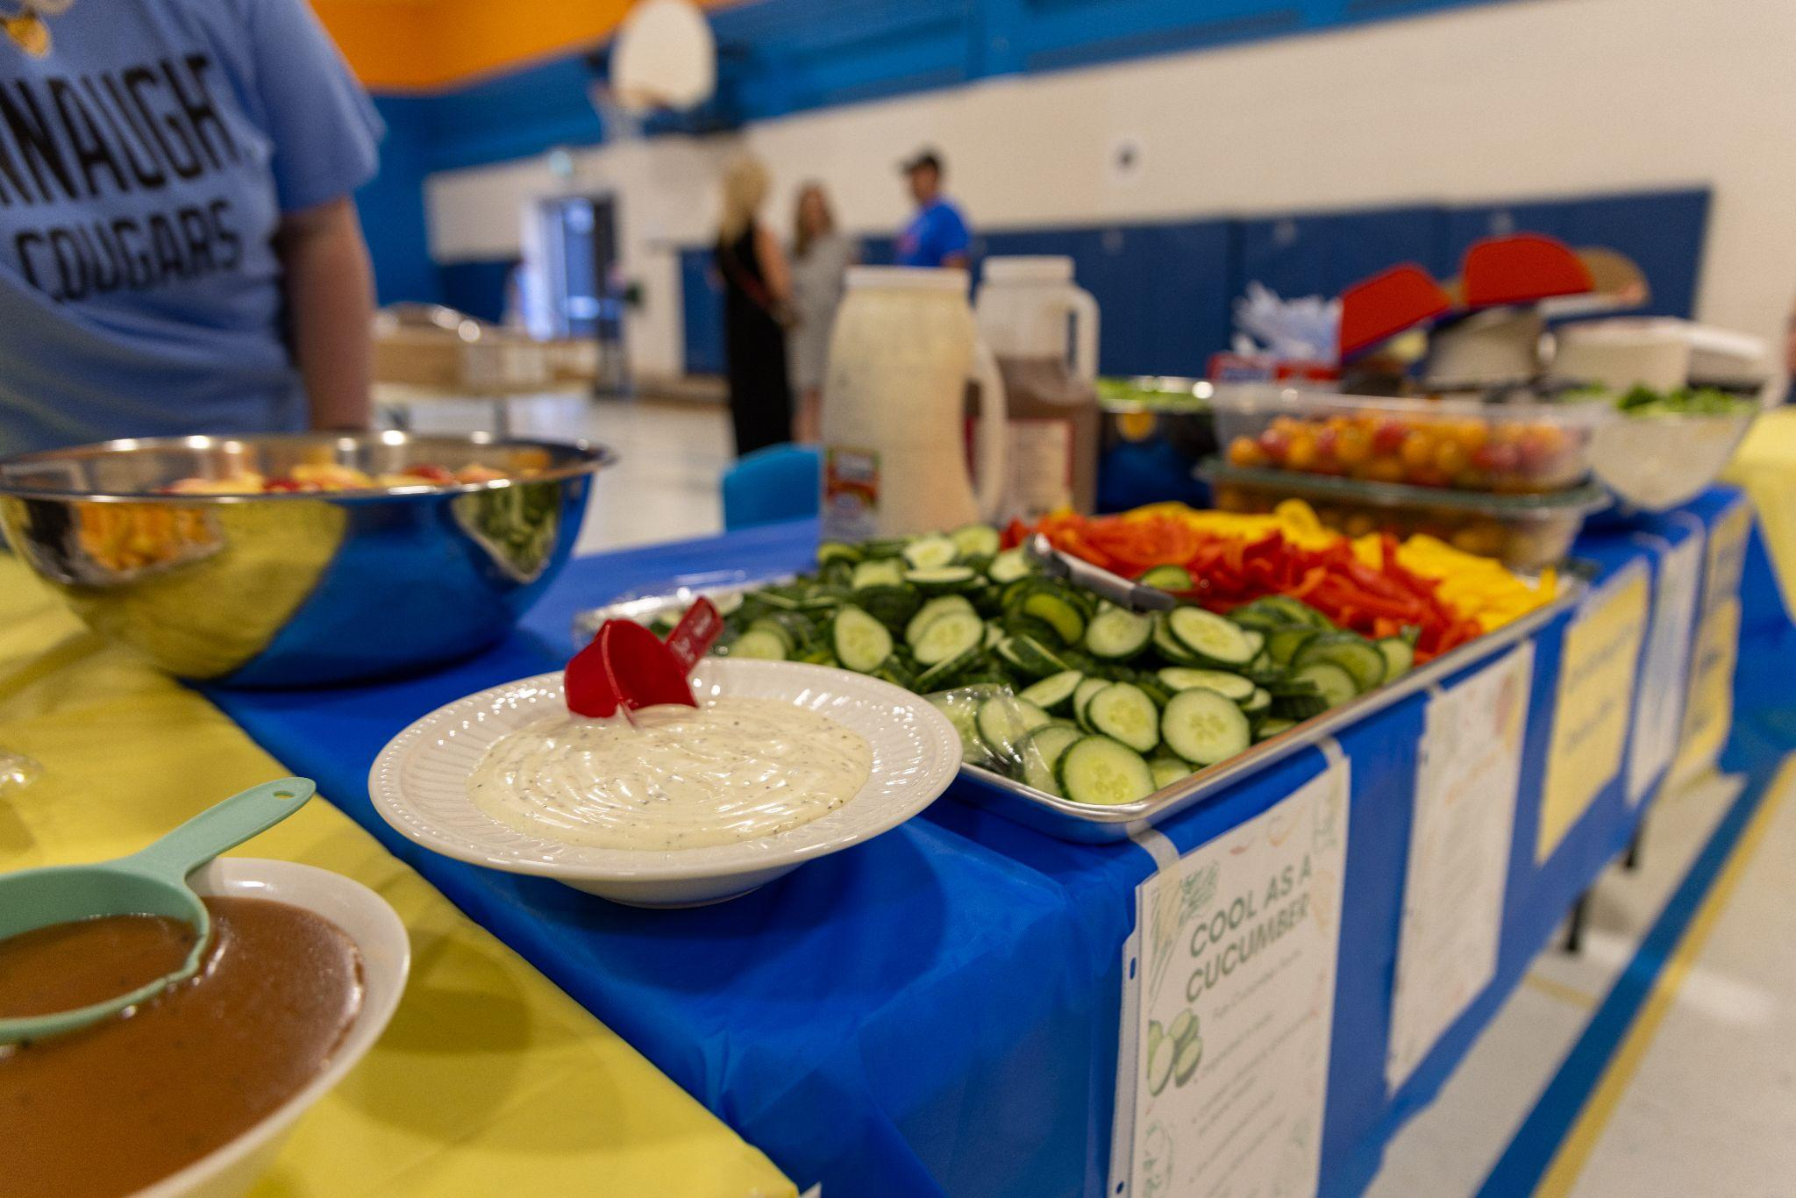
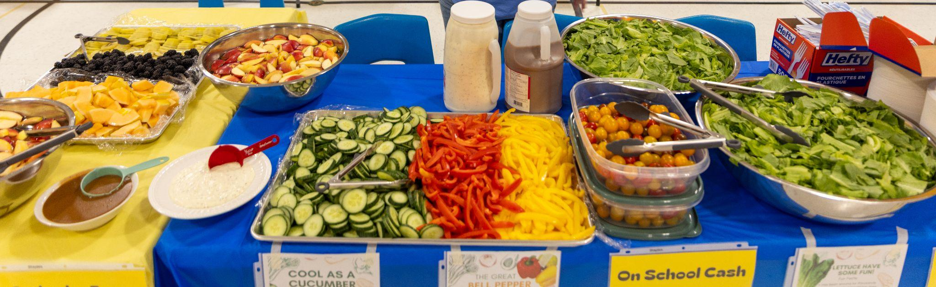

The Impact

Slide 27
The Impact
The market class was also able to visit Puddicombe Farm, a local produce farm. On our trip we learned all about growing produce. We saw a field being prepared for planting, many farm staff busy with tasks that supported the farm, and goats, horses and donkeys. We took a tour of the farm and learned about the planting, picking and distribution process. Students were able to take a train ride, a wagon ride and plant their own seeds to take home. It was a wonderful day full of smiles and learning. Next are a few highlights of the trip!

Slide 28
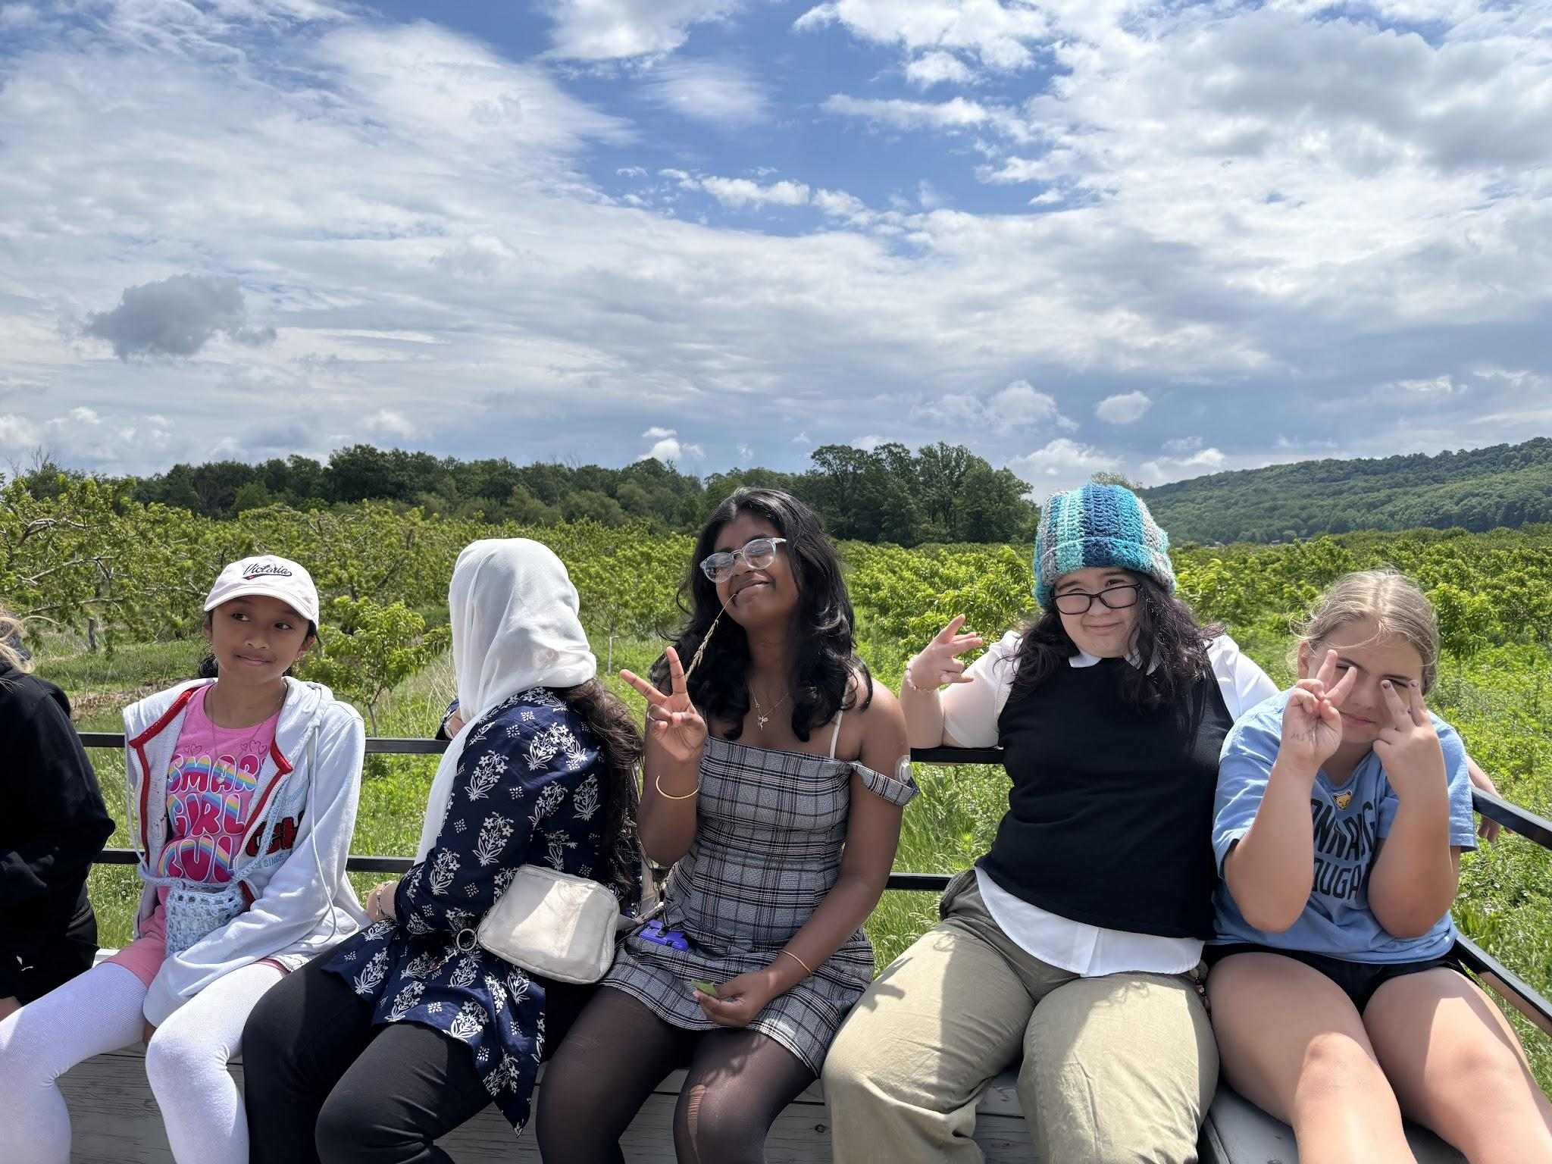

Slide 29
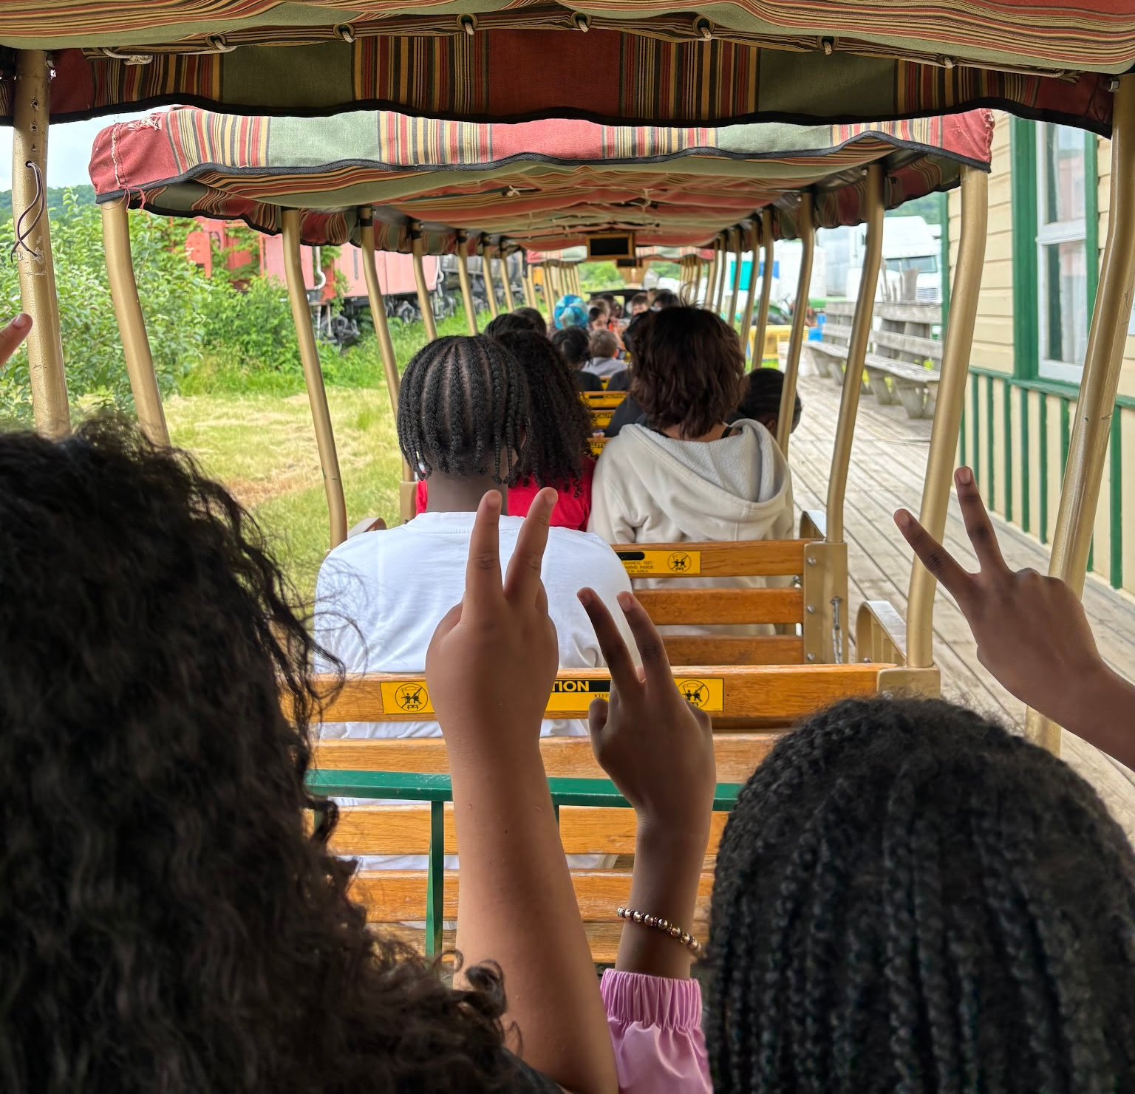

Slide 30
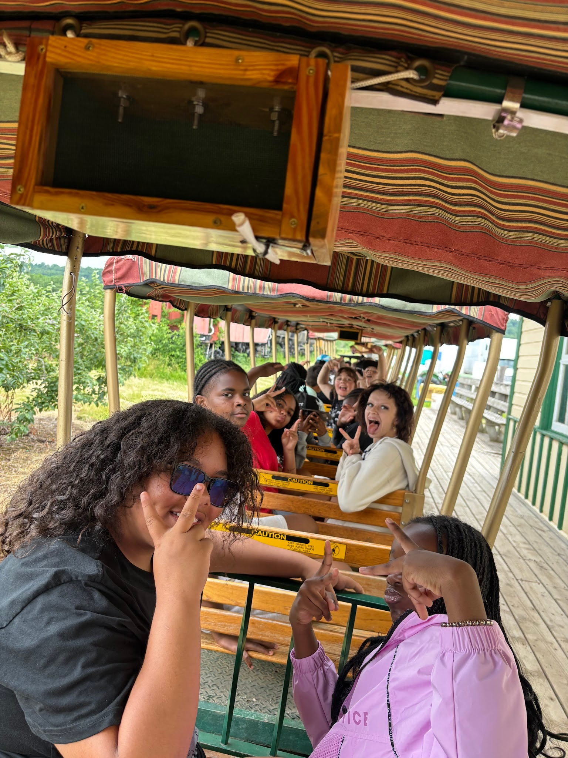

Slide 31
Key Features of Our Breakfast Program
Our breakfast/snack program is supported by community partners to allow all students to have access to nutritious food throughout the school day.
Bins with produce, dairy and breakfast items are located in every classroom. All students have access to the food supplied.
Community partners that support our programs include: Niagara Nutrition Partners, Start Me Up Niagara, Lunch Angels and Food4Kids.

Slide 32
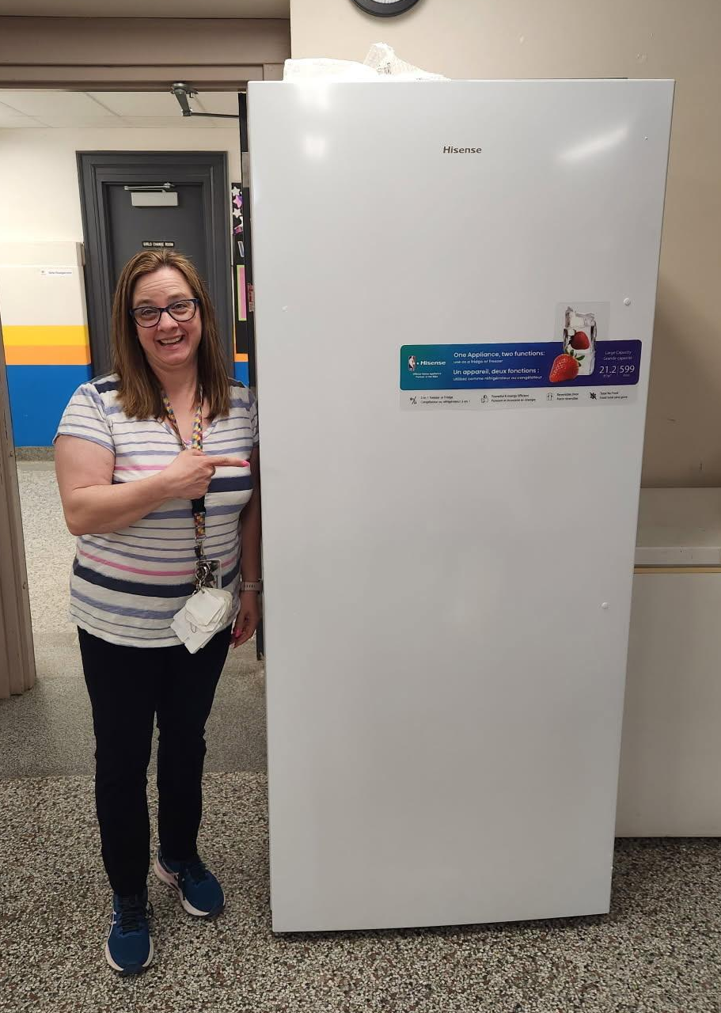
Our LRT Mrs. Palmerino, showing pure excitement about our new fridge! Mrs. P coordinates the support of our community partners to make our breakfast, snack and lunch angels programs happen

Slide 33
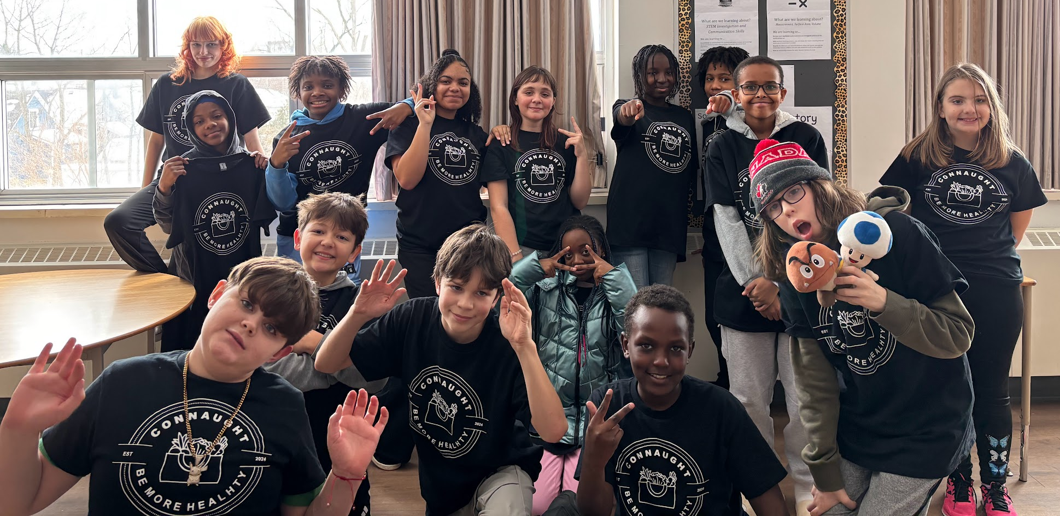
Thank You!

