Slide 1

Notes:
[NOTE TO PRESENTER: Consider including your own logo along with the Say Yes! image]

Slide 2


To the Presenter:
These slides have been developed as a part of Sustain Ontario’s “Say Yes to Good Healthy Food in Schools” initiative, which seeks to provide tools and resources that advocates can use to make the case for school meals and broader school food programs.
Please consider this document as a template – meaning that we encourage you to use it, share it, and modify it to suit your own circumstances.
Here are a few tips to consider when using these PowerPoint slides:
Use as many or as few of these slides as you find helpful. Include your logo, photos, ideas and stories to make the presentation your own.
Be sure to read the text in the Notes section below each slide, which contains talking points and suggestions.
Delete this slide before you make your presentation.
Good luck and have a great presentation!
barrels of oil to make one automobile
Notes:
These slides have been developed as a part of Sustain Ontario’s “Say Yes! to Good Healthy Food in Schools” initiative, which seeks to provide tools and resources that advocates can use to make the case for school meals and broader school food programs.
Please consider this document as a template – meaning that we encourage you to use it, share it, and modify it to suit your own circumstances. This presentation can be used to speak to a variety of audiences, e.g. to advocate to a municipality for more support for your region’s SNP or to advocate to your school board for stronger food literacy education to support and existing meal program.
The presentation’s main emphasis is on meal programs but it embeds the critical importance of food literacy programming.
[NOTE TO PRESENTER: Be sure to delete this slide before you deliver your talk.]

Slide 3
School meals offer a big opportunity for positive change.
Notes:
School meals offer a big opportunity for positive change.

Slide 4
“Nutritious snacks and meals are critical to the success of every child… We want Ontario’s children to reach their full potential and help build a stronger, more prosperous Ontario.”
Teresa Piruzza
Former Minister of Children and Youth Services
Government of Ontario
December 2013
Notes:
When announcing an increase in funding for Student Nutrition Programs in December 2013, Teresa Piruzza, previously Ontario’s Minister of Children and Youth Services, stated that “Nutritious snacks and meals are critical to the success of every child… We want Ontario’s children to reach their full potential and help build a stronger, more prosperous Ontario.”
**
(Reference: See http://www.edu.gov.on.ca/eng/policyfunding/memos/dec2013/NutritionProgramExp.pdf)

Slide 5
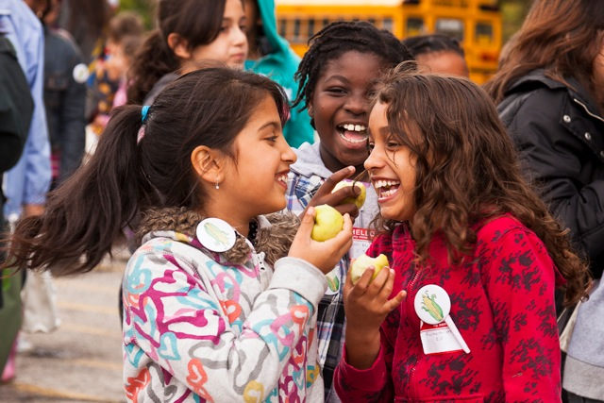
Why do school meals matter?
Notes:
So, why do school meals matter?
(Photo is of students enjoying local apples at Eat in Ontario, a FoodShare Toronto food literacy event; Photo Credit: Laura Berman, GreenFuse Photography)

Slide 6
The healthy eating patterns we develop in childhood tend to be sustained into adulthood.
Health Canada
Notes:
When children establish healthy eating patterns, they are less likely to experiencing chronic diseases later in life. Evidence suggests that the patterns we develop in early childhood tend to be sustained into adulthood.
**
(Reference: Health Canada. (2012). Healthy eating after school: Integrating healthy eating into after-school physical activity initiatives. Ministry of Health. Available at: http://www.hc-sc.gc.ca/fn-an/pubs/nutrition/heas-saae/index-eng.php)

Slide 7
Improved school meals can make an almost immediate difference
in academic achievement.
Journal for Health Economics
Notes:
In fact, according to the Journal for Health Economics, school meals can make an almost immediate difference in academic achievement.
**
(Reference: Michèle Belot and Jonathan James (2011). “Healthy School Meals and Educational Outcomes.”
Journal of Health Economics 303(3), pp. 489–504.)

Slide 8
And they have a positive effect on attendance and class behaviour, too.
Nourishing Young Minds, Toronto Public Health
Notes:
And they have a positive effect on attendance and class behaviour, too.
**
(Reference: Toronto Public Health (2012). Nourishing Young Minds. Available at: http://www.toronto.ca/legdocs/mmis/2012/hl/bgrd/backgroundfile-48313.pdf)

Slide 9
Evidence from Schools:
Feeding Our Future
parts
Notes:
In 2011, the Toronto District School Board released findings from its 2-year Feeding Our Future pilot program that offered nutritious morning meals to all students across four middle schools (grades 6 to 8) and three secondary schools. The evaluation then compared those who ate breakfast (at home and / or at school) on most days of the week with those who skipped the morning meal most days of the week.
**
(Reference: Easwaramoorthy Muthuswamy, (2012). Feeding Our Future: The First- and Second-Year Evaluation. Toronto District School Board. Available at: http://www.tdsb.on.ca/Portals/0/Elementary/docs/SupportingYou/EvaluationFOFProgram19Mar12.pdf).

Slide 10
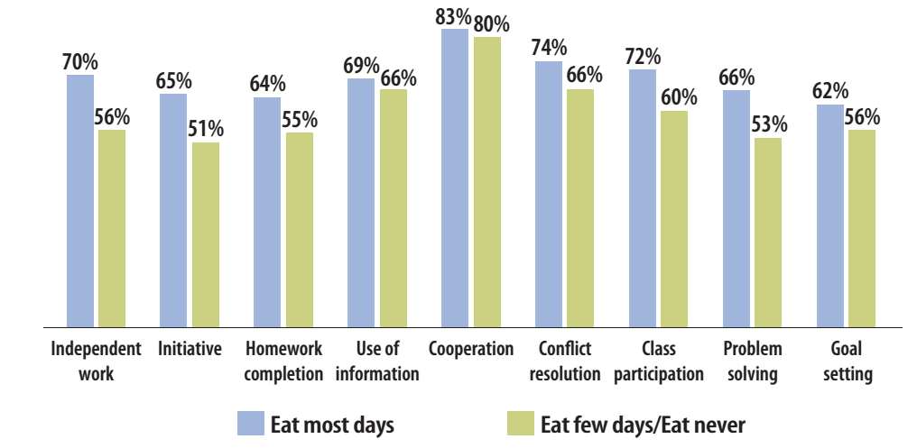
Better results on learning skills
parts
Feeding Our Future, TDSB
Notes:
The results speak for themselves… Students who ate morning meals on most days of the school week achieved better results (i.e., excellent or good) on their learning skills compared with students who only ate morning meals two or less days a week.

Slide 11
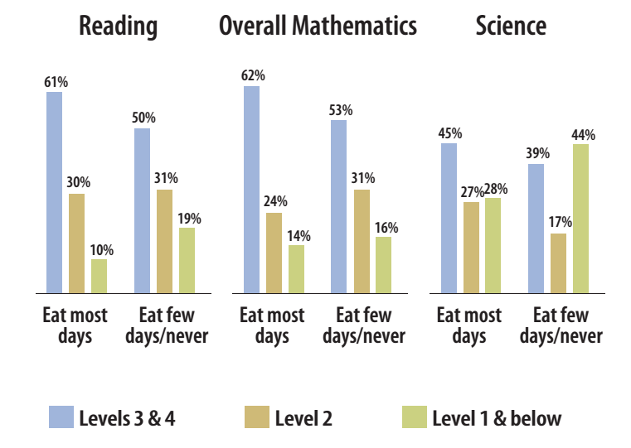
Better grades
parts
Feeding Our Future, TDSB
Notes:
Grade 7 and 8 report card data showed significant differences in Reading, where 61% of students who ate a morning meal on most days achieved or exceeded the provincial standard (levels 3 & 4) as opposed to 50% of those who ate a morning meal two or less times per week.
Another significant difference was the percentage of students (28% for those who ate morning meals on most days vs 44% for those who didn’t) who scored at level 1 or below in Science.

Slide 12
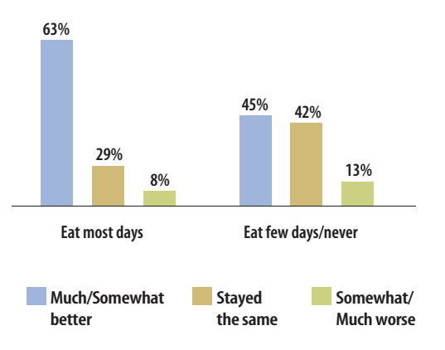
Better perceived health
Feeding Our Future, TDSB
Notes:
Most students also reported that the program improved their health and well-being. Students who ate morning meals on most school days were more likely to perceive their health as excellent or good (75% vs. 58%) and to report better health than the previous school year (63% vs. 45% - see the slide) than those who ate morning meals on fewer days.

Slide 13
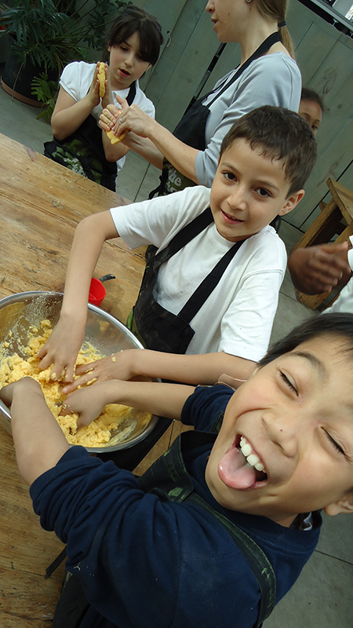
School meals also offer a big opportunity for students to learn food literacy skills
Notes:
While meal programs allow children and youth to achieve greater academic excellence and adopt healthy eating habits, they can also provide opportunities for supportive food literacy education that can engage students to learn skills that will enable them to make healthy food choices throughout their lives.
Food literacy education can be advanced through a wide range of efforts in schools including school gardens, cooking programs, learning about food and nutrition during classroom lessons, and taking part in farm tours. An example of how Student Nutrition Programs and Food Literacy can complement one another is that hands-on food skills education can be integrated into meal and snack programs by involving children and youth in planning, preparing, serving, and sharing food and beverages.
Food literacy programs can also amplify the benefits of student meals by getting students excited about choosing, trying and eating healthy options.
(Photo is of youth learning to make arepas at The Stop Community Food Centre)

Slide 14
How many students participate in nutrition programs in Ontario?
Notes:
You might be asking how many students participate in nutrition programs in Ontario?

Slide 15

700,000+
ONTARIO STUDENTS
WHO RECEIVE SCHOOL MEALS
parts
Ontario Ministry of Children and Youth Services
Notes:
The Ontario Ministry of Children and Youth Services estimates that around 690,000 students benefitted from meal programs during the 2011-2012 school year.
This number will rise above 700,000 students for the 2013-2014 school year. In 2013 the province expanded its annual investment to more than $20 million and its 2014 budget committed to increasing the provincial contribution to a total annual investment of $32 million by 2016–17. This most recent investment will support an additional 56,000 children to receive school meals, including those attending on-reserve First Nation schools.
**
(Reference: Ontario Ministry of Children and Youth Services. October 1, 2013 News Release: Healthier Snacks and Meals on the Menu at More Ontario Schools.)
[NOTE TO PRESENTER: Consider adding a slide after this one that shows YOUR community’s daily and monthly meals.]

Slide 16
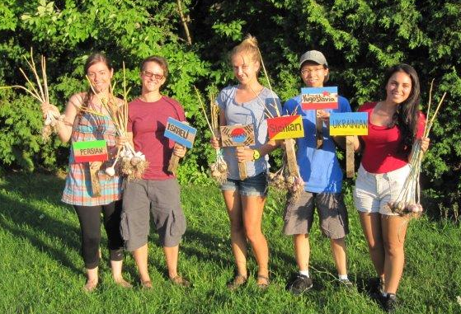
So why is your support needed?
Notes:
So why is your support needed?
(Photo credit: Seeds For Change)

Slide 17
Because the Government of Ontario’s contribution can only go so far.
parts
Notes:
Because the Government of Ontario’s contribution can only go so far.
The reality is that the government funds up to 15% of a program’s costs, and this funding only goes to select priority neighbourhoods and schools. This means that many schools don’t have meal programs and those that do receive government support still need to fundraise the additional 85% of the program’s costs.
**
Potential additional comments: On December 9, 2013, the Government of Ontario provided an additional investment $3M to SNPs as part of its response to the Healthy Kids Panel, bringing its yearly investment to approximately $21M.
In its July 14, 2014 budget the Government of Ontario then announced that it will be expanding the Student Nutrition Program by funding 340 new breakfast programs for an additional 56,000 students in higher-needs elementary and secondary schools. On-reserve First Nation communities have been included in this expansion and will have the opportunity to lead the development and delivery of Student Nutrition Program models that address the unique strengths and needs of their communities.

Slide 18
SNPs rely on financial and volunteer support from parents and caregivers, municipalities, corporate sponsors, farmers, local charities, and community organizations.
parts
Notes:
Student Nutrition Programs in Ontario therefore rely on support from parents and caregivers, municipalities, corporate sponsors, farmers, local charities, community organizations and many others to make them happen.

Slide 19
School meals are especially important
for some students.
Notes:
School meals are especially important for some students.

Slide 20
24%
Percentage of Grade 4 students who do not eat breakfast every day.
Canadian Journal of Public Health
Notes:
In Canada, over 24% of Grade 4 students do not eat breakfast every day.
**
(Reference: Evers S, Taylor J, Manske S, Midgett C. Eating and smoking behaviours of school children in southwestern Ontario and Charlottetown, PEI. Canadian Journal of Public Health, 2001; 92: 433-436).

Slide 21


47% 33%
Percentage of students who skip breakfast by Grade 8.
Canadian Journal of Public Health
Notes:
By grade 8, the number of students skipping breakfast rises to 47% of girls and 33% of boys.
**
(Reference: Evers S, Taylor J, Manske S, Midgett C. Eating and smoking behaviours of school children in southwestern Ontario and Charlottetown, PEI. Canadian Journal of Public Health, 2001; 92: 433-436).

Slide 22
Students may skip breakfast for many reasons. One of these is poverty.
Notes:
Students may skip breakfast for many reasons. One of these is poverty.

Slide 23
# of Canadian children who lived in households that struggled to afford the food they needed in 2012
1.15 MILLION
PROOF – reporting on Statistics Canada data
Notes:
In 2012, around 1.15 million Canadian children lived in food insecure households – meaning that their families struggled to afford the food they needed.
**
(Reference: Tarasuk, V, Mitchell, A, Dachner, N. (2014). Household food insecurity in Canada, 2012.
Toronto: Research to identify policy options to reduce food insecurity (PROOF). Available at: http://nutritionalsciences.lamp.utoronto.ca/resources/proof-annual-reports/annual-report-2012/)

Slide 24


1 out of 7
Children in Ontario who lived in
food insecure households in 2012
PROOF – reporting on Statistics Canada data
Notes:
When we just look at Ontario, the stats tell us that 1 out of 7 (15.2% of) children live in food insecure households.
**
(Reference: Tarasuk, V, Mitchell, A, Dachner, N. (2014). Household food insecurity in Canada, 2012.
Toronto: Research to identify policy options to reduce food insecurity (PROOF). Available at: http://nutritionalsciences.lamp.utoronto.ca/resources/proof-annual-reports/annual-report-2012/)
The study is based on data from the Canadian Community Health Survey, 2012, which refers to household food insecurity as "the inability to acquire or consume an adequate diet quality or sufficient quantity of food in socially acceptable ways, or the uncertainty that one will be able to do so”. (see http://www.hc-sc.gc.ca/fn-an/surveill/nutrition/commun/insecurit/index-eng.php).

Slide 25
Children may also come to school hungry because of lengthy commutes, early morning practices, not being hungry when they wake up, and busy family routines.
parts
Notes:
At the same time, it’s important to realize that poverty is only one of the reasons that children and youth may not eat a morning meal and that all students can benefit from meal programs.
Children may come to school hungry for a number of other reasons including lengthy commutes, early morning practices, not being hungry when they wake up, and busy family routines in the morning.
A Universal program makes it so that all children can eat at least one healthy meal or snack each day and that they are ready to learn when they come into the classroom.

Slide 26
Why else do
healthy school meals matter?
Notes:
So why else do healthy school meals matter?

Slide 27
In addition to improving academic achievement and alleviating hunger, healthy school meals help to promote
overall student health.
parts
Notes:
In addition to improving academic achievement and alleviating hunger, healthy school meals help to promote overall student health – not just for children who live in poverty.

Slide 28
Children in Ontario at an unhealthy weight
1out of 3
No Time to Wait - Healthy Kids Panel
Notes:
As we keep hearing, childhood overweight and obesity are rising. Almost 1 in 3 children in Ontario is now an unhealthy weight.
**
(Reference: Healthy Kids Panel. (2013). No time to wait: The healthy kids strategy. Queen's Printer for Ontario: Toronto, Ontario.)

Slide 29
“If nothing is done, the current generation of children in Ontario will be the first that has a lower quality of life than their parents. They will develop chronic illnesses much younger and be more affected as they age”
barrels of oil to make one automobile
No Time to Wait - Healthy Kids Panel
Notes:
No Time to Wait - Ontario’s Healthy Kids Strategy – has stated that this is problematic because “If nothing is done, the current generation of children in Ontario will be the first that has a lower quality of life than their parents. They will develop chronic illnesses much younger and be more affected as they age”.
**
(Reference: Healthy Kids Panel. (2013). No time to wait: The healthy kids strategy. Queen's Printer for Ontario: Toronto, Ontario.)

Slide 30
Only half of youth in Ontario consume the recommended number of vegetable and fruit servings per day
barrels of oil to make one automobile
Public Health Ontario
Notes:
Moreover, only half of youth in Ontario consume the recommended number of vegetable and fruit servings per day. This is a prevalent issue that runs across family income levels.
**
(Reference: Ontario Agency for Health Protection and Promotion (Public Health Ontario). (2013). Addressing obesity in children and youth: Evidence to guide action for Ontario. Queen’s Printer for Ontario: Toronto, Canada. Available at: http://www.publichealthontario.ca/en/eRepository/Addressing_Obesity_Children_Youth_Sept2013.pdf).

Slide 31
These trends are worrisome for many reasons, including for the costs of our health care system.
barrels of oil to make one automobile
Notes:
These trends are worrisome for many reasons, including for the costs of our health care system.

Slide 32
Cost of obesity in Ontario in 2009
$4.5 BILLION
No Time to Wait - Healthy Kids Panel referencing
The Health and Fitness Journal of Canada
Notes:
In 2009, obesity cost Ontario around $4.5 billion. This was made up of approximately $1.6 billion in direct health care costs and $2.87 billion in indirect costs. While these costs included adults too, our future health care costs could be dramatically reduced by supporting healthy kids.

Slide 33
Schools with healthy eating programs have significantly lower
rates of obesity.
Notes:
But the good news is that schools with healthy eating programs have significantly lower rates of obesity.

Slide 34
Other community benefits and learning opportunities.
Notes:
Comprehensive meal programs can provide and support a wide range of other community benefits and learning opportunities.

Slide 35
School is the biggest restaurant chain in every city and every town. Only nobody knows it.
David Binkle
Director, Food Service
Los Angeles Unified School District
Notes:
David Binkle, the food service director at Los Angeles Unified, says that, “School is the biggest restaurant chain in every city and every town. Only nobody knows it.”

Slide 36
Working collectively, schools can help create enough demand to support
sustainable regional agriculture...
Notes:
Working collectively, schools can help create enough demand to support sustainable regional agriculture...

Slide 37
…as we have seen in so many successful
farm-to-school programs.
Notes:
…as we have seen in so many successful farm to school programs.

Slide 38
These successes can
translate into local
prosperity.
Notes:
These successes translate can into local prosperity.

Slide 39
Every dollar spent on local food adds between $1.4 - $2.6 to the local economy.
$1= $1.86
Notes:
A baseline that people often use is that spending $1 on local food adds somewhere between $1.4-$2.6 to the wider local economy. (This range is closer to $1.4 in areas where there are primarily large-scale farms and $2.6 in areas with mainly small-scale farms.)
**
(Reference: see http://sustainontario.com/2012/07/04/11208/news/multiplier-effect#_ednref11)

Slide 40
If each Ontario household spent $10 a week on local food we would add $2.4 billion to our local economy and create 10,000 jobs.
Ogryzlo, $10 Challenge
Notes:
It is estimated that if every household in Ontario spent $10 a week on local food, we would have an additional $2.4 billion in our local economy at the end of the year and create 10,000 new jobs.
**
(Reference: see http://www.ontariotable.com/10-challenge-billion-dollar-impact/)

Slide 41
Imagine the impact that our schools could have on our local economy if they bought local food when they could!
Notes:
Imagine the impact that our schools could have on our local economy if they bought local food when they could!

Slide 42
Meal programs also offer an incredible opportunity to provide good food education, as we can see from examples across Ontario.
Notes:
Meal programs also offer an incredible opportunity to provide and support good food education in our schools, as we can see from examples across Ontario.

Slide 43
3Acres Tastebuds Local Harvest Program in Hamilton brings local food to the Student Nutrition Programs by bicycle and exposes students to new food items.
Notes:
3Acres Tastebuds Local Harvest Program in Hamilton brings local food to the Student Nutrition Programs by bicycle and exposes students to new food items. Schools are given recipes so that they can make use of the ingredients in creative ways, and the program also provides profiles of vegetables for students to learn from.

Slide 44
The Wake Up Wellington Program in Fergus involves culinary arts students to help prepare fresh and nutritious foods for the school meal program.
Notes:
The Wake Up Wellington Program in Fergus involves culinary arts students to help prepare fresh and nutritious foods for the school meal program. The students also gain baking and cooking skills.

Slide 45
Students in the Glen Shields Breakfast Program in Concord work together, based on their abilities, to help with organizing, setting up, preparing, and cleaning up after school meals.
Notes:
Students in the Glen Shields Breakfast Program in Concord work together, based on their abilities, to help with organizing, setting up, preparing, and cleaning up after school meals.
Students discuss and provide input into what meals to prepare. Older students learn responsibility and build community by assisting in running the program, and helping young students with tasks like pouring milk and cutting food.
The program has become a catalyst for making friends, getting homework help from teachers, and participating in daily arts and crafts. It has created a community with a focus on health and eating together.

Slide 46
Public Support
Notes:
The power of healthy school meals and food education are well recognized by the public.

Slide 47
2010
FoodShare Toronto
Survey
Notes:
For example, a telephone poll of over 1000 respondents cross Ontario that was conducted in September 2010 for FoodShare Toronto revealed that…

Slide 48
95%
Adults who agree that children should learn about healthy eating in school.
FoodShare Toronto
Notes:
95% of adults agree that children should be learning about food and healthy eating in school as a way to combat obesity and diabetes. This overall level of agreement was consistent across almost all demographics and regions. You can see that 73% strongly agreed with this statement while 22% responded that they somewhat agreed with it.

Slide 49
95%
Adults who supported making ‘food literacy’ part of the school curriculum in Ontario
FoodShare Toronto
Notes:
95% supported the idea of the Ontario government making ‘food literacy’ – teaching students where food comes from, how
to cook, how to grow food and how to eat healthy – part of the mainstream school curriculum in Ontario. (66% expressed strong support for this concept while 29% expressed that they somewhat support the idea)

Slide 50
76%
Adults who felt that Ontario should require all schools to serve at least 1 healthy meal
FoodShare Toronto
Notes:
76% supported the idea of the Ontario government directing all Ontario schools to provide at least one healthy meal including fresh vegetables and fruits and whole grains in the course of the school day. (48% expressed strong support for this concept while 28% expressed that they somewhat support the idea). Note that this question asked about whether the government of Ontario should direct schools to provide a healthy meal, not whether schools should provide a healthy meal. If the question had asked whether schools should serve healthy meals the numbers likely would have been even higher.

Slide 51
88%
Support for incentives so that schools can buy and serve local food
FoodShare Toronto
Notes:
88% supported the idea that the Ontario government should provide incentives for schools to buy and serve locally-produced food (52% expressed strong support for this concept while 37% expressed that they somewhat support the idea).

Slide 52
87%
Support for Ontario to require schools to build gardens and composters
FoodShare Toronto
Notes:
87% supported the idea that the Ontario government should direct all schools with available land to build gardens and composters so that students can participate in a hands-on way in the food cycle, while getting physical exercise (51% expressed strong support for this concept while 36% expressed that they somewhat support the idea).

Slide 53
85%
Support teaching every student
how to cook
FoodShare Toronto
Notes:
85% supported the idea that students should be taught how to cook (44% expressed strong support for this concept while 41% expressed that they somewhat support the idea).

Slide 54
It’s a vision we can all share.
Notes:
School food programs are a huge success and a vision we all can share.

Slide 55
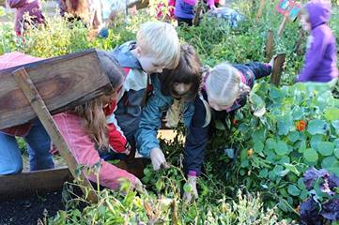
Healthy children
and youth.
Notes:
Healthy children and youth.
[NOTE TO PRESENTER: Consider including photographs from your region that show healthy children and good food.]
(Photo is of a harvest exploration at Evergreen Heights in Emsdale, Ontario; Photo Credit: Kelli Ebbs)

Slide 56
Improved learning
outcomes.
Notes:
Improved learning outcomes.
[NOTE TO PRESENTER: Consider including photographs from your district that show healthy children and good food.]

Slide 57
Reduced absenteeism and tardiness.
Notes:
Reduced absenteeism and tardiness.
[NOTE TO PRESENTER: Consider including photographs from your district that show healthy children and good food.]

Slide 58
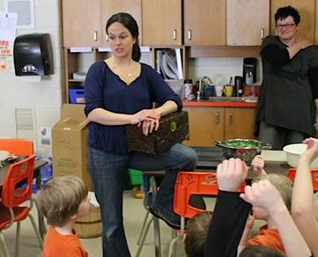
Improved classroom behaviour.
Notes:
Improved classroom behaviour.
[NOTE TO PRESENTER: Consider including photographs from your district that show healthy children and good food.]
(Photo is of a classroom in Evergreen Heights in Emsdale, Ontario. Each week, the class’ holistic nutritionist would put a new vegetable inside and the kids played 20 questions to guess what it is. One week, in the very early stages of the program, not one kid knew what a beet was. That changed.; Photo Credit: Kelli Ebbs)

Slide 59
Positive relationship building.
Notes:
Positive relationship building.
[NOTE TO PRESENTER: Consider including photographs from your district that show healthy children and good food.]

Slide 60
Healthier local economies, including more jobs.
Notes:
Healthier local economies, including more jobs.
[NOTE TO PRESENTER: Consider including photographs from your district that show healthy children and good food.]

Slide 61
More prudent use of our resources, including natural resources.
Notes:
More prudent use of our resources, including natural resources.
[NOTE TO PRESENTER: Consider including photographs from your district that show healthy children and good food.]

Slide 62
And the opportunity to make a real and lasting contribution to the future.
Notes:
The opportunity to make a real and lasting contribution to the future.
[NOTE TO PRESENTER: Consider including photographs from your district that show healthy children and good food.]

Slide 63
A strong program needs support from everyone (parents, volunteers, teachers, school staff & boards, farmers, local businesses, community groups, governments, students…)
Notes:
Building a strong program will require support from everyone including parents, community volunteers, teachers, school staff and boards, farmers, local businesses, community organizations, governments

Slide 64
What are you doing to Say Yes! to good healthy food in schools?
Notes:
What are you doing to Say Yes! to good healthy food in schools?

Slide 65


This project was made possible through funding from the Heart and Stroke Foundation.
This presentation has been adapted from the Center for Ecoliteracy’s Making the Case template, available at: http://www.ecoliteracy.org/downloads/making-case

Slide 66
More Say Yes! to Good Healthy Food in Schools resources are available at:
sustainontario.com/work/edible-education/say-yes/.

